Slide 1

San Joaquin County
Plausible Threat 2017 Tabletop Exercise
September 29, 2017

Slide 2
EXERCISE OVERVIEW

Slide 3
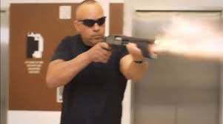
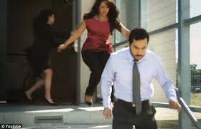
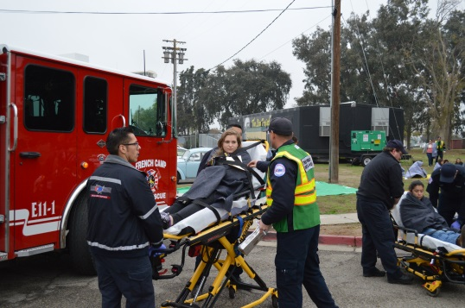
CORE CAPABILITIES
Operational Coordination
Operational Communications
On-Scene Security, Protection and Law Enforcement
Public Health, Healthcare and Emergency Medical Services

Slide 4
OBJECTIVES
Evaluate the San Joaquin County Active Threat Plan in response to a simulated Active Shooter/Hostile Event (ASHE).
Improve participants understanding of the San Joaquin County Active Threat Plan and use of a Rescue Taskforce

Slide 5
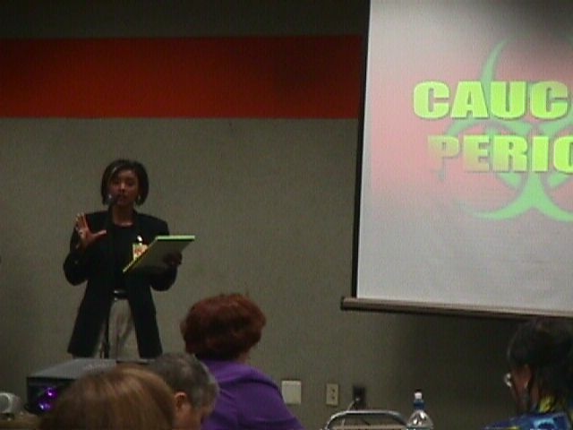
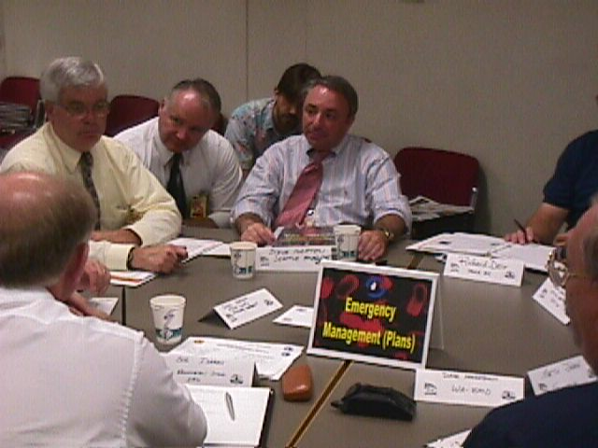
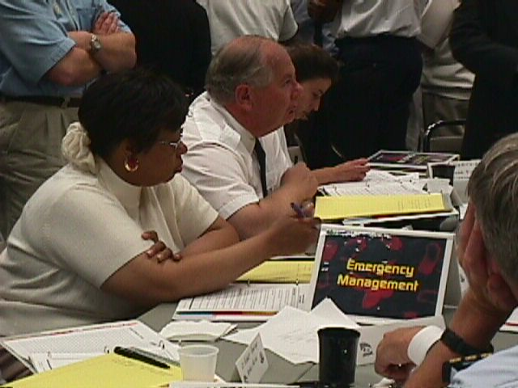
EXERCISE STRUCTURE
Two Modules
Scenario & Situation Updates
Breakout Sessions
Facilitated Discussions

Slide 6
FUNCTIONAL GROUPS
Field Responders
San Joaquin Operational Area Healthcare Coalition

Slide 7
FUNCTIONAL GROUPS
Select a spokesperson
Select a scribe

Slide 8
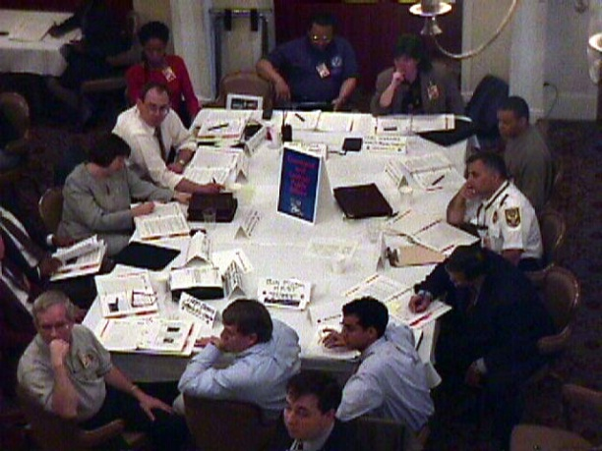
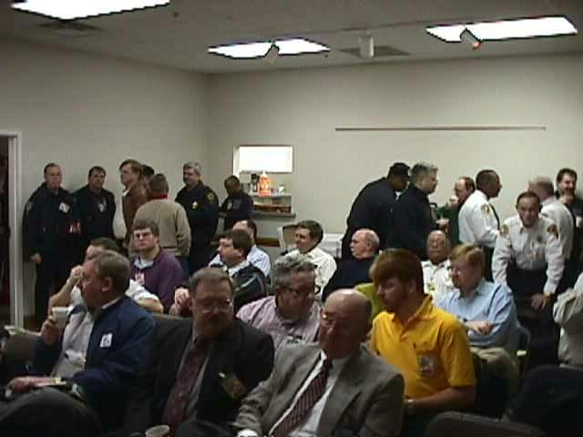
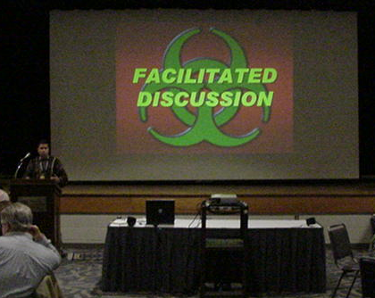
ROLES & RESPONSIBILITIES
Players
Observers
Personnel who have an active role in discussing or performing their regular roles and responsibilities during the exercise. Players discuss or initiate actions in response to the simulated emergency.
Do not directly participate in the exercise; however they may support the group in developing responses to the situation during the discussion.
Moderate the flow of discussion
Facilitator

Slide 9
EXERCISE GUIDELINES
This exercise will be held in an open, low-stress, no-fault environment. Varying viewpoints, even disagreements, as expected.
Respond to the scenario using your knowledge of current plans and capabilities (i.e., you may use only existing assets or resources) and insights derived from your training.
Decisions are not precedent setting and may not reflect your organization’s final position on a given issue.
No-Fault, Low-Stress Environment

Slide 10
EXERCISE GUIDELINES
This exercise is an opportunity to discuss and present multiple options and possible solutions.
Issue identification is not as valuable as suggestions and recommended actions that could improve response efforts. Problem solving efforts should be the focus.
During the exercise, if a player states that they are going to ask for/provide mutual aid, they need to state specifically under which plan and to which agency they will do so.

Slide 11
ASSUMPTIONS & ARTIFICIALITIES
The scenario is plausible; events occur as they are presented
There no “Hidden Agendas” or trick questions
All players receive information at the same time
Fight the problems, not the scenario

Slide 12
ADMINISTRATIVE
Breaks
Evaluation Forms
  Participant Feedback Forms

Slide 13
EXERCISE SCHEDULE
0830 Welcome and Overview
0845 Module 1
0945 BREAK
0955 Module 2
1125 BREAK
1135 Hot Wash and Closing Comments
1200 End
See Appendix A

Slide 14
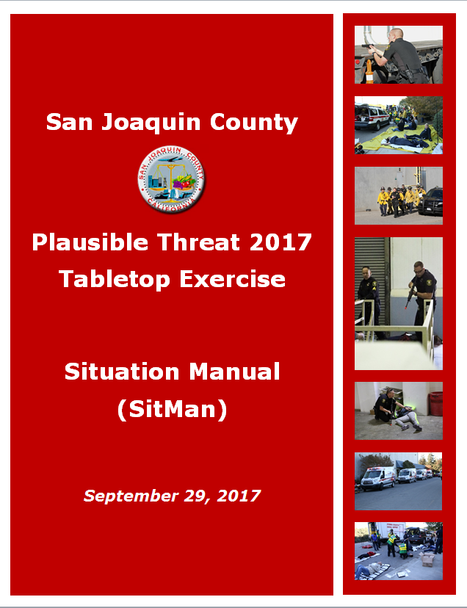

BEGIN EXERCISE

Slide 15

Module 1: Initial Response

Slide 16
Breakout
Session

Slide 17
FACILITATED DISCUSSION

Slide 18
BREAK

Slide 19

Module 2: Reinforced Response

Slide 20
Breakout
Session

Slide 21
FACILITATED DISCUSSION

Slide 22
END OF EXERCISE

Slide 23
PLAYER’S HOT WASH
Strengths
Areas for improvement
Policies, plans, etc.
Role and responsibilities
Communications & coordination
Any needed resources

Slide 24
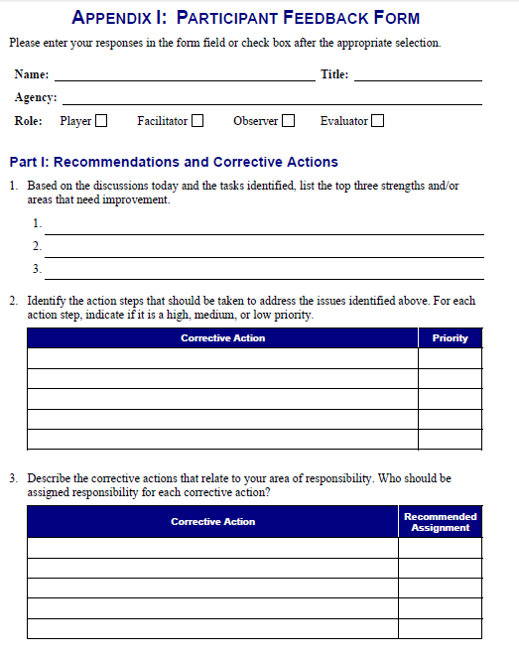
FEEDBACK FORM

Slide 25
EXERCISE PROGRAM
Full-Scale Exercise:
  November 15, 2017

Slide 26
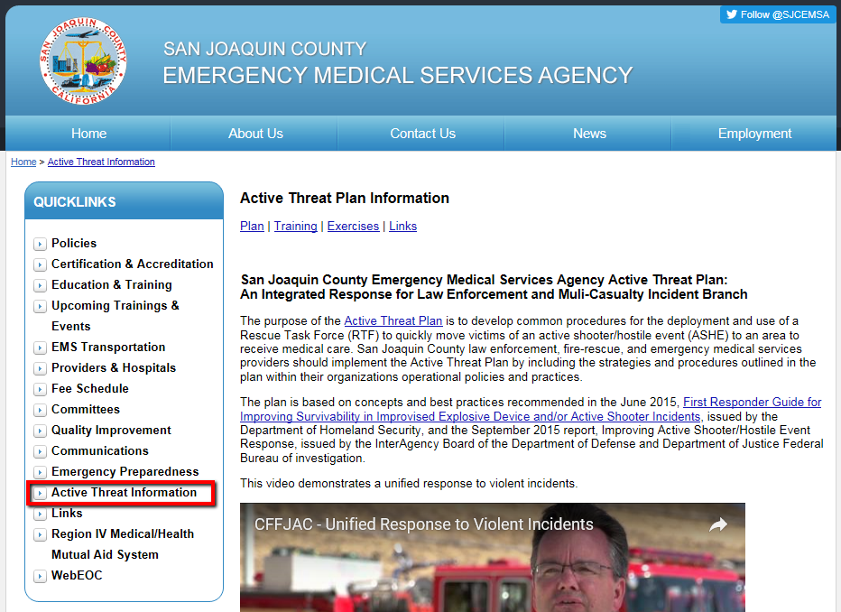
EXERCISE MATERIALS
All exercise materials will be available on the EMS Agency website sjgov.org/ems/activethreatplan.html

Slide 27
CLOSING COMMENTS

Slide 28
THANK YOU

