Slide 1

San Joaquin County
Plausible Threat 2016 Control Facility Operations Tabletop Exercise
August 11, 2016

Slide 2
EXERCISE OVERVIEW

Slide 3
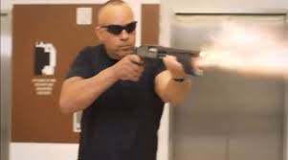
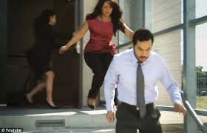
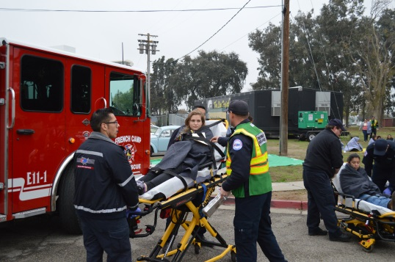
CORE CAPABILITIES
Operational Coordination
Operational Communications
Public Health, Healthcare and Emergency Medical Services

Slide 4
OBJECTIVES
Evaluate plans for patient distribution from a large scale Active Shooter/Hostile Event (Region IV MCI Plan).
Evaluate hospital surge plans, including Operating Room surge.

Slide 5
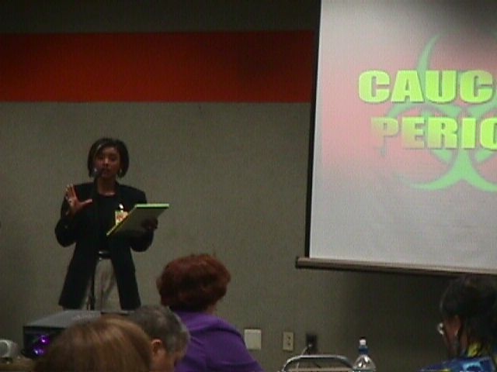
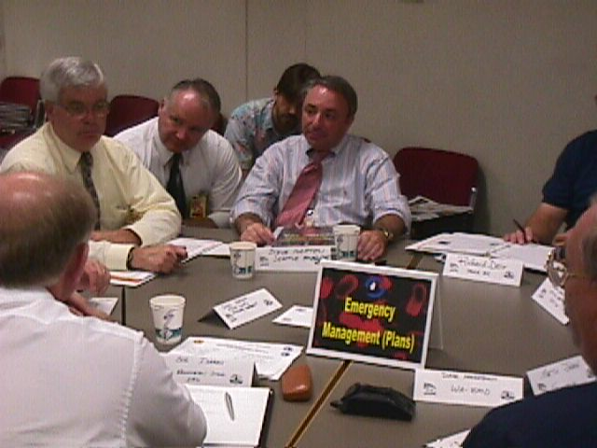
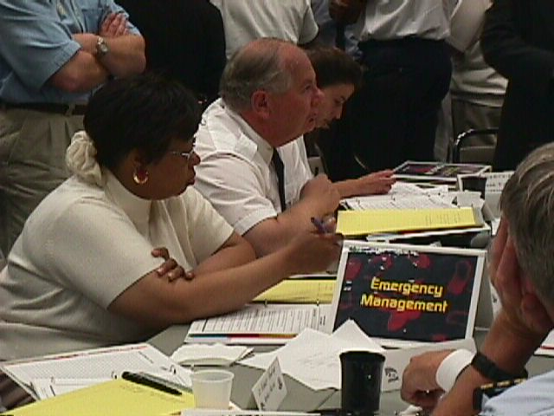
EXERCISE STRUCTURE
Three Modules
Scenario & Situation Updates
Breakout Sessions
Facilitated Discussions

Slide 6
FUNCTIONAL GROUPS
Hospitals: Dameron, Doctor’s, Kaiser, Lodi Memorial, San Joaquin General, St. Joseph’s, Sutter Tracy
Behavioral Health

Slide 7
FUNCTIONAL GROUPS
Select a spokesperson
Select a scribe

Slide 8
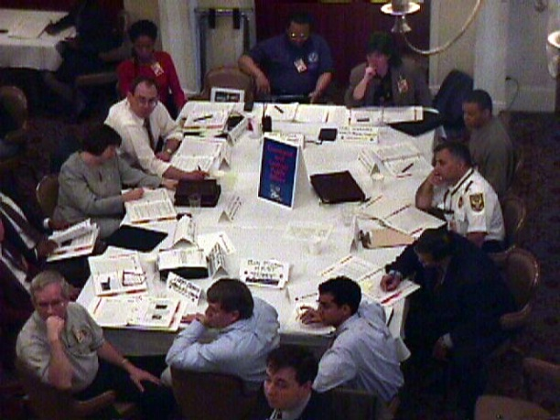
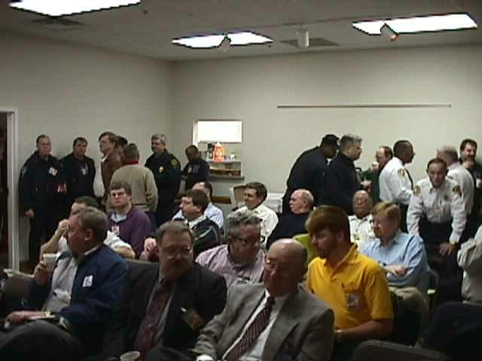
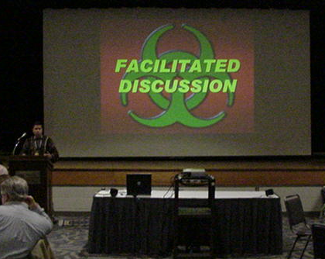
ROLES & RESPONSIBILITIES
Players
Observers
Personnel who have an active role in discussing or performing their regular roles and responsibilities during the exercise. Players discuss or initiate actions in response to the simulated emergency.
Do not directly participate in the exercise; however they may support the group in developing responses to the situation during the discussion.
Moderate the flow of discussion
Facilitator

Slide 9
EXERCISE GUIDELINES
This exercise will be held in an open, low-stress, no-fault environment. Varying viewpoints, even disagreements, as expected.
Respond to the scenario using your knowledge of current plans and capabilities (i.e., you may use only existing assets or resources) and insights derived from your training.
Decisions are not precedent setting and may not reflect your organization’s final position on a given issue.
No-Fault, Low-Stress Environment

Slide 10
EXERCISE GUIDELINES
This exercise is an opportunity to discuss and present multiple options and possible solutions.
Issue identification is not as valuable as suggestions and recommended actions that could improve response efforts. Problem solving efforts should be the focus.

Slide 11
ASSUMPTIONS & ARTIFICIALITIES
The scenario is plausible; events occur as they are presented
The high school is located in each functional group’s jurisdiction.
There no “Hidden Agendas” or trick questions
Fight the problems, not the scenario

Slide 12
ASSUMPTIONS & ARTIFICIALITIES
All participants receive information at the same time

Slide 13
ADMINISTRATIVE
Breaks
Evaluation Forms
  Participant Feedback Forms
  EMS/BRN CEU Evaluation Forms

Slide 14
EXERCISE SCHEDULE
0800 Welcome and Overview
0815 Module 1
0915 BREAK
0925 Module 2
1025 BREAK
1035 Module 3
1135 Hot Wash and Closing Comments
1200 End

Slide 15

BEGIN EXERCISE

Slide 16
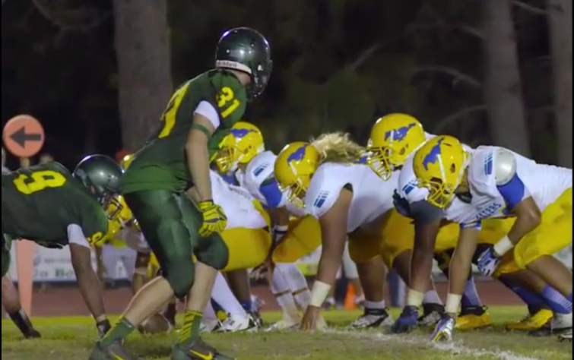
Module 1: Initial Event
September
23, 2016
1930 Hours
Paradise verses San Joaquin football game begins, hosted by the home team Paradise High School. There are approximately 650 people in attendance.

Slide 17
Module 1: Initial Response
September
23, 2016
1948 Hours
With 6:55 minutes remaining in the second quarter, an explosion in the home team bleachers occurs. Immediately following the explosion, gunshots are heard and several people are shot.
Panic ensues, spectators and players begin running in all directions. The location of the shooter(s) is unknown at this time.
The local PSAPs are inundated with 9-1-1 calls reporting the explosion and shooting. Additional gunshot can be heard in the background by one of the dispatchers receiving a call.

Slide 18
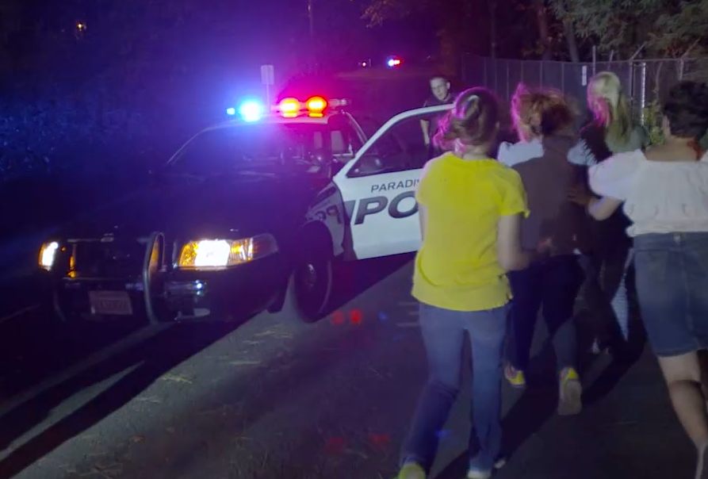
Module 1: Initial Event
September
23, 2016
1950 Hours
Law, Fire and EMS are dispatched to the incident

Slide 19
Module 1: Initial Event
September
23, 2016
1954 Hours
“County Base, Medic 18 calling to declare an MCI”
“Medic 18 declaring an MCI, we have an active shooter and an explosion in progress, we will call this the Paradise Incident, I will be the Paradise Medical Group Supervisor, the patient count is evolving and I will call you back in approximately 5 minutes with the first round of triage to provide you patient numbers”.

Slide 20
Breakout
Session

Slide 21
FACILITATED DISCUSSION

Slide 22
Module 2: MCI Update
“County Base this the Paradise MGS with an update on the Paradise Incident”
“Paradise MGS the first sweep of triage had been completed; please keep in mind the patient count is evolving between 40-50 patients. At this time I have 19 patients accounted for with the following patient count and categories;
Immediate Pediatric = 1
Immediate Adult = 4
Delayed = 4
Minor = 10”
“I am ready for destinations for the 19 patients at this time”
September
23, 2016
1959 Hours

Slide 23
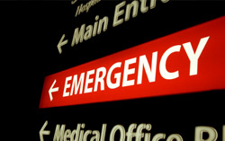
Module 2: MCI Update
September
23, 2016
2008 Hours
Self presenting patients from the Paradise incident arrive at local hospitals.

Slide 24
Module 2: MCI Update
September
23, 2016
2010 Hours
“County Base this the Paradise MGS with an update on the Paradise Incident”
“Paradise MGS upon secondary assessment 1 delayed patient met major trauma triage criteria and they are now categorized as an immediate. Please confirm or change the destination for this patient”.
“Paradise MGS another round of triage is complete. At this time I have 10 additional patients accounted for, with the following patient count and categories that I will need additional destinations on;

Slide 25
Module 2: MCI Update
September
23, 2016
2010 Hours
“Paradise MGS another round of triage is complete. At this time I have 10 additional patients accounted for, with the following patient count and categories that I will need additional destinations on;
Immediate Adult = 4
Delayed = 2
Minor = 4”

Slide 26

Module 2: MCI Update
What
happened
in the field

Slide 27
Breakout
Session

Slide 28
FACILITATED DISCUSSION

Slide 29
Module 3: Patient Distribution
2015 Hours
Total Patient Count = 29:
Immediate Pediatric = 1
Immediate Adult = 8 (one patient upgraded from a delayed)
Delayed = 5
Minor = 14

Slide 30
Module 3: Patient Distribution
“County Base this the Paradise MGS with an update on the Paradise Incident”
“Paradise MGS all patients have been transport off scene at this time. The MCI has ended”
2030 Hours

Slide 31
Breakout
Session

Slide 32
FACILITATED DISCUSSION

Slide 33
END OF EXERCISE

Slide 34
PLAYER’S HOT WASH
Strengths
Areas for improvement
Policies, plans, etc.
Role and responsibilities
Communications & coordination
Any needed resources

Slide 35
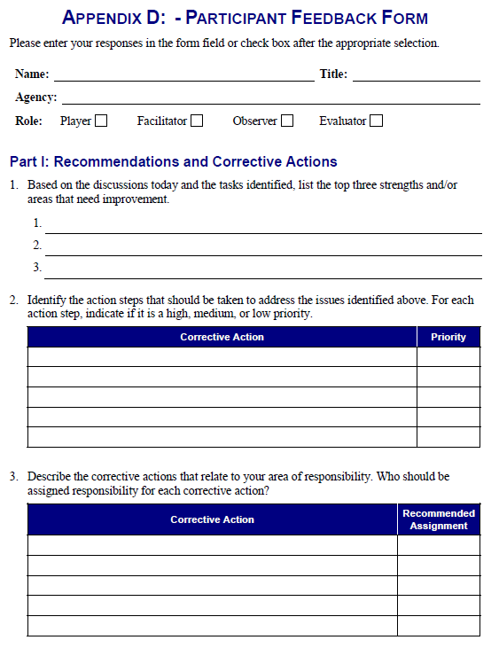
FEEDBACK FORM

Slide 36
EXERCISE PROGRAM
Tabletop Exercises:
  Multi-Casualty Branch Operations August 23, 2016
Full-Scale Exercise:
  November 16, 2016

Slide 37

EXERCISE PROGRAM
Hospital Training and Preparedness:
15 ‘til 50 – Mass Casualty Incident Toolkit http://cdphready.org/15-til-50-mass-casualty-incident-toolkit/
Notes:
http://cdphready.org/15-til-50-mass-casualty-incident-toolkit/
Recorded Webinar; http://cdphready.org/recorded-webinar-15-til-50/

Slide 38

EXERCISE PROGRAM
Responder Training:
CFFJAC – Unified Response to Violent Incidents
Notes:
YouTube Video: https://www.youtube.com/watch?v=VCMPx6z_-J8
Embed Code: <iframe width="640" height="360" src="https://www.youtube.com/embed/VCMPx6z_-J8" frameborder="0" allowfullscreen></iframe>

Slide 39
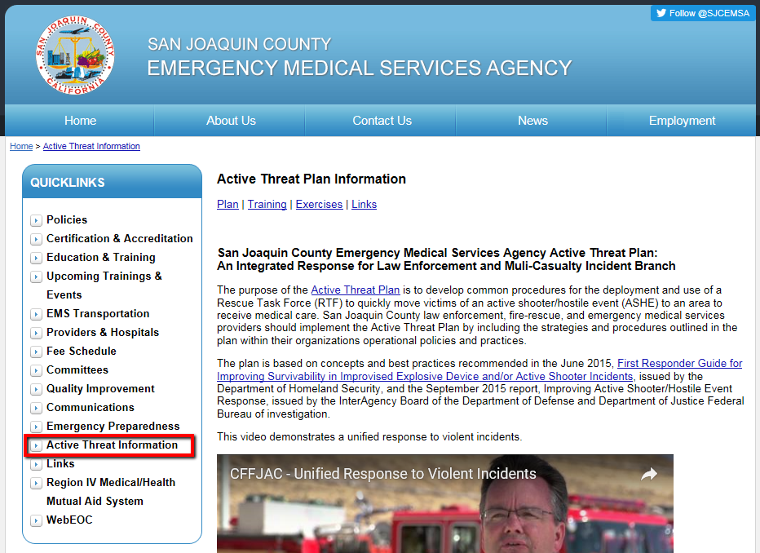
EXERCISE MATERIALS
All exercise materials will be available on the EMS Agency website sjgov.org/ems/activethreatplan.html

Slide 40
CLOSING COMMENTS

Slide 41
THANK YOU

