Slide 1

San Joaquin County
Plausible Threat 2016 Multi-Casualty Branch Operations Tabletop Exercise
August 23, 2016

Slide 2
EXERCISE OVERVIEW

Slide 3
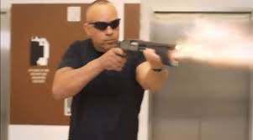
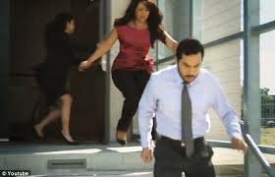
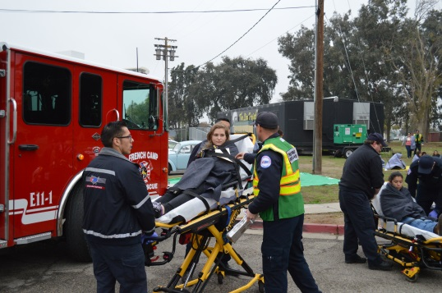
CORE CAPABILITIES
Operational Coordination
Operational Communications
Public Health, Healthcare and Emergency Medical Services

Slide 4
OBJECTIVES
Evaluate the San Joaquin County Active Threat and Region IV MCI Plans in response to a simulated Active Shooter/Hostile Event (ASHE).
Improve participants understanding of the San Joaquin County Active Threat and Region IV MCI Plans

Slide 5
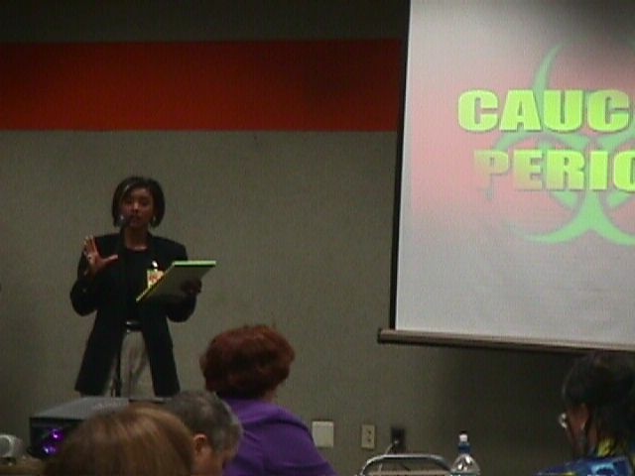
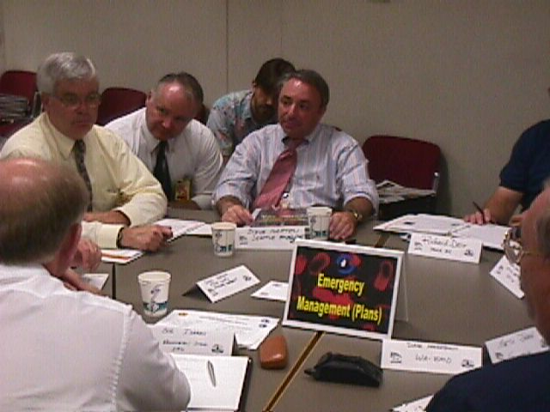
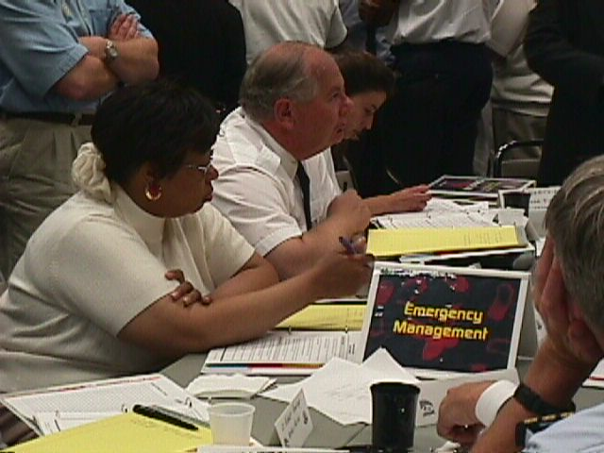
EXERCISE STRUCTURE
Three Modules
Scenario & Situation Updates
Breakout Sessions
Facilitated Discussions

Slide 6
FUNCTIONAL GROUPS
Multi-Casualty Branch
Control Facility

Slide 7
FUNCTIONAL GROUPS
Select a spokesperson
Select a scribe

Slide 8
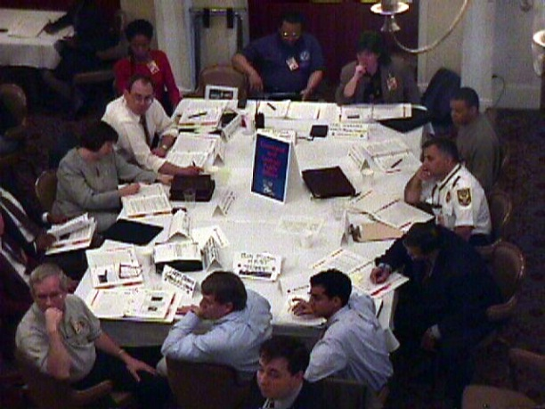
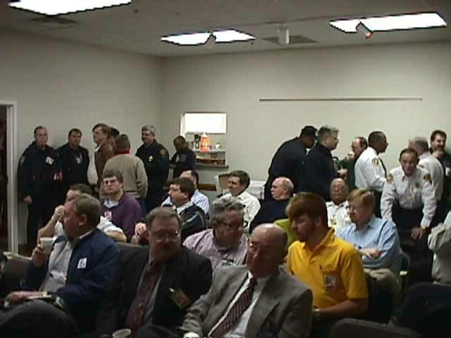
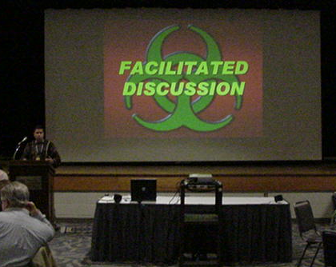
ROLES & RESPONSIBILITIES
Players
Observers
Personnel who have an active role in discussing or performing their regular roles and responsibilities during the exercise. Players discuss or initiate actions in response to the simulated emergency.
Do not directly participate in the exercise; however they may support the group in developing responses to the situation during the discussion.
Moderate the flow of discussion
Facilitator

Slide 9
EXERCISE GUIDELINES
This exercise will be held in an open, low-stress, no-fault environment. Varying viewpoints, even disagreements, as expected.
Respond to the scenario using your knowledge of current plans and capabilities (i.e., you may use only existing assets or resources) and insights derived from your training.
Decisions are not precedent setting and may not reflect your organization’s final position on a given issue.
No-Fault, Low-Stress Environment

Slide 10
EXERCISE GUIDELINES
This exercise is an opportunity to discuss and present multiple options and possible solutions.
Issue identification is not as valuable as suggestions and recommended actions that could improve response efforts. Problem solving efforts should be the focus.
During the exercise, if a player states that they are going to ask for/provide mutual aid, they need to state specifically under which plan and to which agency they will do so.

Slide 11
ASSUMPTIONS & ARTIFICIALITIES
The scenario is plausible; events occur as they are presented
There no “Hidden Agendas” or trick questions
Fight the problems, not the scenario

Slide 12
ASSUMPTIONS & ARTIFICIALITIES
All participants receive information at the same time
The high school is located in the French Camp-McKinley Fire District

Slide 13
ADMINISTRATIVE
Breaks
Evaluation Forms
  Participant Feedback Forms
  EMS/BRN CEU Evaluation Forms

Slide 14
EXERCISE SCHEDULE
0800 Welcome and Overview
0815 Module 1
0915 BREAK
0925 Module 2
1025 BREAK
1035 Module 3
1135 Hot Wash and Closing Comments
1200 End

Slide 15
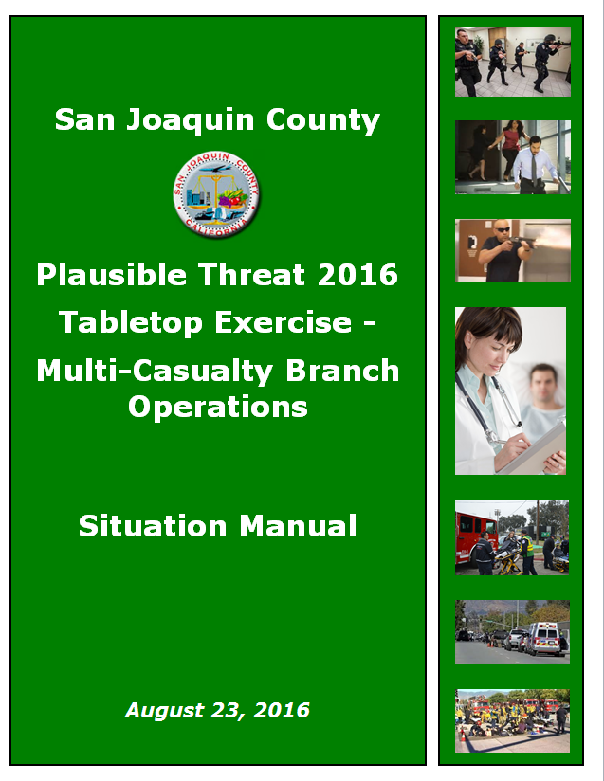

BEGIN EXERCISE

Slide 16
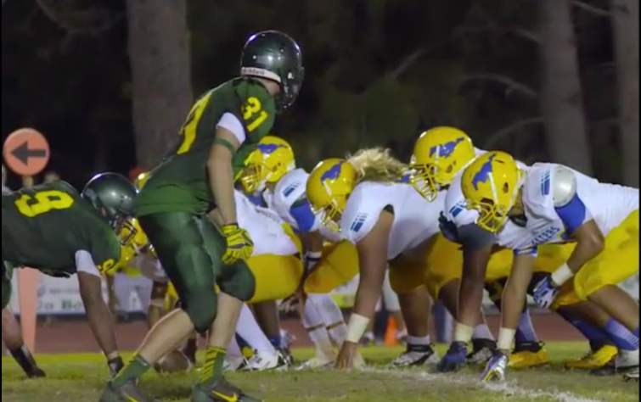
Module 1: Initial Response
September
23, 2016
1930 Hours
Paradise verses San Joaquin football game begins, hosted by the home team Paradise High School. There are approximately 650 people in attendance.

Slide 17

Module 1: Initial Response
September
23, 2016
1948 Hours

Slide 18
Module 1: Initial Response
September
23, 2016
1948 Hours
Panic ensues, spectators and players begin running in all directions. The location of the shooter(s) is unknown at this time.
The local PSAPs are inundated with 9-1-1 calls reporting the explosion and shooting. Additional gunshot can be heard in the background by one of the dispatchers receiving a call.
September
23, 2016
1950 Hours
Law, Fire and EMS are dispatched to the incident.

Slide 19
Breakout
Session

Slide 20
FACILITATED DISCUSSION

Slide 21
BREAK

Slide 22
Module 2: Reinforced Response
September
23, 2016
1954 Hours

Slide 23
Module 2: Reinforced Response
September
23, 2016
1954 Hours
Law enforcement arrives on scene. People are running and screaming as they flee the scene.
Fire and ALS ambulances arrive.

Slide 24
Module 2: Reinforced Response
September
23, 2016
1955 Hours
As the Contact Team approaches the football stadium they encounter a suspect with a handgun, who begins shooting at them.
The suspect is wounded and is taken into custody.
The suspect confesses to planting one bomb in the bleachers and that a second shooter is located on top of the gymnasium.

Slide 25
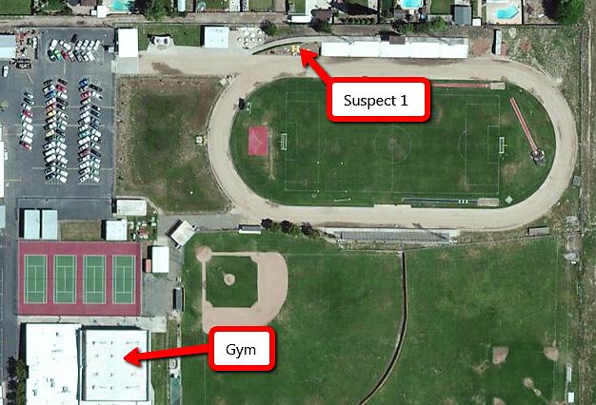
Module 2: Reinforced Response
September
23, 2016
1955 Hours

Slide 26
Module 2: Reinforced Response
September
23, 2016
1957 Hours
The location of the second suspect is relayed to additional Law Enforcement personnel, who converge upon the gymnasium.
A witness runs out of the south door of the gym and reports that there is a guy shooting inside the men’s locker room with a rifle; and that at least three people have been shot.

Slide 27
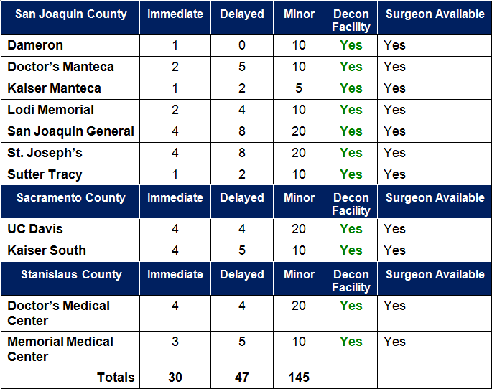
Module 2: Reinforced Response
September
23, 2016
1958 Hours
Current Hospital ED Bed Poll.

Slide 28
Breakout
Session

Slide 29
FACILITATED DISCUSSION

Slide 30
BREAK

Slide 31
Module 3: Multi-Branch Response
September
23, 2016
2002 Hours
Suspect 2, inside the gym, sends one hostage out with a message for Law Enforcement that he wants to be allowed to leave or he will shoot everyone one inside the gym.
The hostage provides the suspect’s cell phone number and reports that there are eight other people inside, three of them have been shot. All victims were still alive when he was sent outside.
Upon further questioning, suspect 1 confirms with there are no other bombs or shooters on-scene.

Slide 32
Module 3: Multi-Branch Response
September
23, 2016
2003 Hours
The Multi-Casually Branch Director has been informed by the Operations Section Chief that the football stadium has been designated as the Warm Zone and the Rescue Task Force is ready to evacuate patients and victims.

Slide 33
Module 3: Multi-Branch Response
September
23, 2016
2005 Hours
Law Enforcement establishes a perimeter around the gym and is attempting to make telephone contact with the suspect.
The Rescue Task Force enters the Warm Zone and begins evacuating patients and victims.
Patients are being triaged and are readied for transport as there are transferred to the Triage Group through the Casualty Collection Point
The Patient Transportation Group Supervisor (PTGS) provides the Disaster Control Facility with an initial patient count
2006-2015
Hours

Slide 34
Module 3: Multi-Branch Response
September
23, 2016
2010 Hours
Law Enforcement establishes a telephone contact with suspect 2, who is being cooperative.
Law Enforcement conducts interviews with victims evacuated by the Rescue Task Force.
2012 Hours
The Litter Bearers report to the Triage Unit Leader that all surviving patients have been evacuated from the stadium.
2030 Hours

Slide 35
Breakout
Session

Slide 36
FACILITATED DISCUSSION

Slide 37
END OF EXERCISE

Slide 38
PLAYER’S HOT WASH
Strengths
Areas for improvement
Policies, plans, etc.
Role and responsibilities
Communications & coordination
Any needed resources

Slide 39
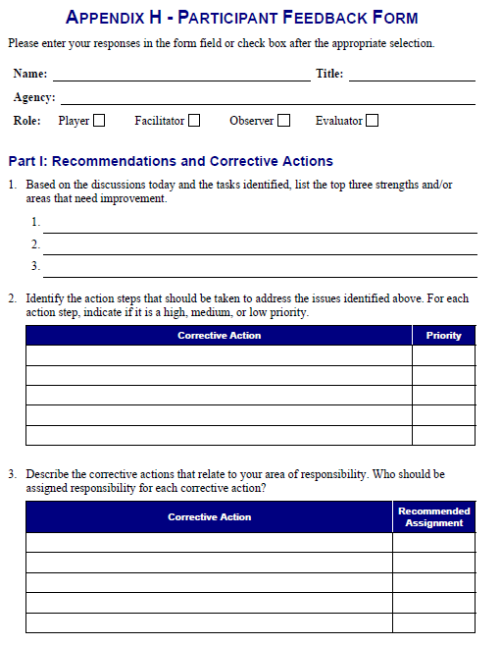
FEEDBACK FORM

Slide 40
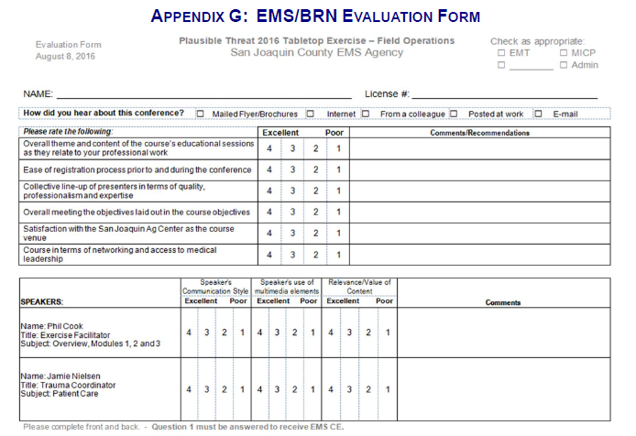
EMS/BRN EVALUATION

Slide 41
EXERCISE PROGRAM
Full-Scale Exercise:
  November 16, 2016

Slide 42

EXERCISE PROGRAM
Training:
CFFJAC – Unified Response to Violent Incidents
Notes:
Embed code <iframe width="854" height="480" src="https://www.youtube.com/embed/VCMPx6z_-J8" frameborder="0" allowfullscreen></iframe>
IP https://www.youtube.com/watch?v=VCMPx6z_-J8

Slide 43
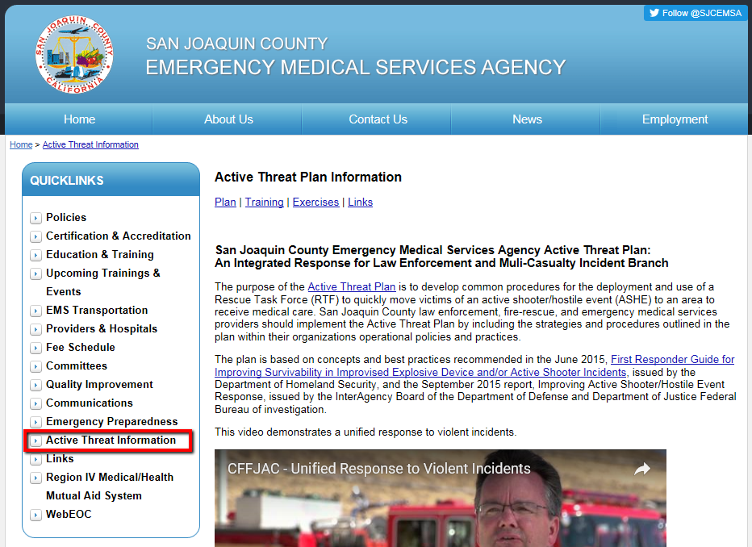
EXERCISE MATERIALS
All exercise materials will be available on the EMS Agency website sjgov.org/ems/activethreatplan.html

Slide 44
CLOSING COMMENTS

Slide 45
THANK YOU

