Slide 1

San Joaquin County
Long Term Care Facility
Evacuation Plan
Training

Slide 2

San Joaquin County
Emergency Medical Services Agency
Welcome
Objective:
  Provide participants with an understanding of the San Joaquin County LTCF Evacuation Plan, and their role in the plan.

Slide 3
San Joaquin County
Emergency Medical Services Agency
At the conclusion of this training session participants will be able to:
  Identify the purpose, scope and authority of the plan
  Identify the related concepts of operation (ICS, mutual aid, etc.)
  Explain the three Emergency Evacuation Destination Categories (Levels I, II, III)

Slide 4
San Joaquin County
Emergency Medical Services Agency
be able to ….
  Explain the four Evacuation Status Categories (Status A, B, C & D)
  Identify the difference between an emergent and planned evacuation
  Identify the difference between a single and multiple facility evacuation

Slide 5
San Joaquin County
Emergency Medical Services Agency
be able to ….
  Explain how to activate this plan and the required notifications
  Describe how to “Shelter-in-Place” and explain when this action would be preferred over an evacuation
  How to incorporate the county plan into your facility’s evacuation plan

Slide 6
San Joaquin County
Emergency Medical Services Agency
be able to ….
  Complete the forms (LTC 401, 402, 403, etc.)
  Use the Facility Evacuation Checklist and Flowchart
  Signup to receive alerts from the California Health Alert Network (CAHAN)

Slide 7
San Joaquin County
Emergency Medical Services Agency
be able to ….
  Explain why you want to activate the plan early
  Explain that you do not loose control of your facility by activating this plan
TEAM WORK

Slide 8
San Joaquin County
Emergency Medical Services Agency
Purpose and Scope
  The purpose of this plan is to ensure the orderly and timely movement of patients/residents from single or multiple facilities which need to be evacuated to a safe location.
  This plan is intended for all Skilled Nursing Facilities, as defined by Title 22 CCR Section 72103, located within San Joaquin County.

Slide 9
San Joaquin County
Emergency Medical Services Agency
Authority
  This plan is issued under the joint authority of the San Joaquin County Emergency Medical Services Agency Administrator and the San Joaquin County Public Health Officer.
  (California Health and Safety Code, Division 2.5, Article 4, Sections 1797.150)

Slide 10
San Joaquin County
Emergency Medical Services Agency
Planning Assumptions
  All facilities are vulnerable to internal and external threats that could require a facility to evacuate or shelter-in-place, e.g., fire, utility failure, disease outbreak, hazardous materials spill.
  Threatening events can happen suddenly without warning or may develop slowly over a period of hours, days or weeks.
  This plan doesn’t replace or supersede the emergency operations and/or evacuation plans of individual facilities.

Slide 11
San Joaquin County
Emergency Medical Services Agency
Concept of Operations
  Use of the Incident Command System (ICS)
  Information Sharing
  Control of Patient/Resident Dispersal
  Mutual Aid
  Emergency Evacuation Destination Categories
  Evacuation Status Categories

Slide 12
San Joaquin County
Emergency Medical Services Agency
Incident Command System
  Once the decision is made to evacuate a facility, the facility will be designated an incident site. A Unified Incident Command will be established at the facility, which will be comprised of facility officials and other public safety agencies with jurisdictional or statutory authority (EMS, Public Health, Fire, Law, etc.)

Slide 13
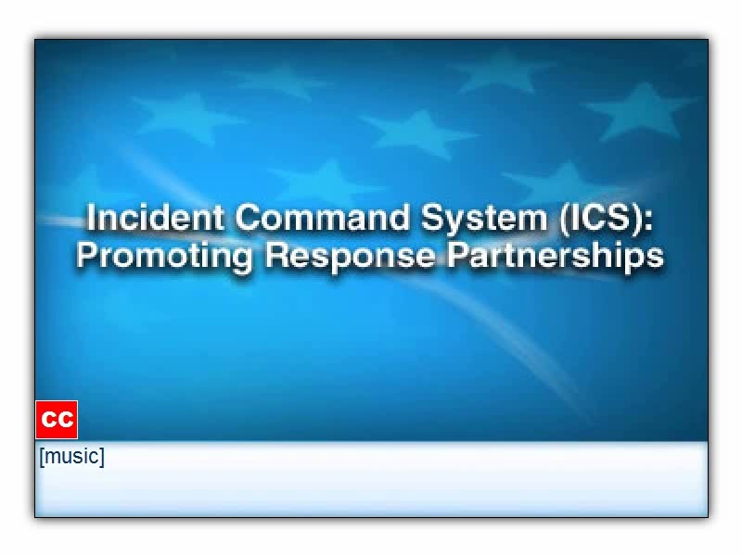
ICS-100 Training Course Video
FEMA – Emergency Management Institute

Slide 14
Incident
Commander
Safety Officer
Public Information
Officer
Liaison Officer
Operations
Section Chief
Logistics
Section Chief
Planning
Section Chief
Finance
Section Chief
Medical Branch
Director
The Basic Incident Command
System Structure
Medical Group
Supervisor
Patient Transport
Group Supervisor

Slide 15
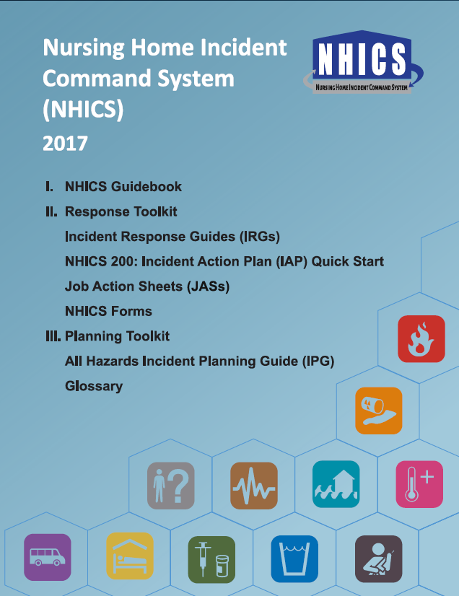


Slide 16
San Joaquin County
Emergency Medical Services Agency
Incident Command System
  For more information about ICS and FREE online training go to the FEMA website
  http://training.fema.gov/IS/crslist.asp
    IS-100 Introduction to the Incident Command System (ICS)
    IS-200 ICS for Single Resources and Initial Action Incidents
    IS-700 National Incident Management System
    IS-800 National Response Framework

Slide 17
San Joaquin County
Emergency Medical Services Agency
Information Sharing
  Information sharing is necessary for maintaining a common operating picture of emergency operations.
  The information sharing process is detailed in the San Joaquin Operational Area Healthcare Coalition Governance Document https://sjgov.org/ems/coalition.htm.

Slide 18
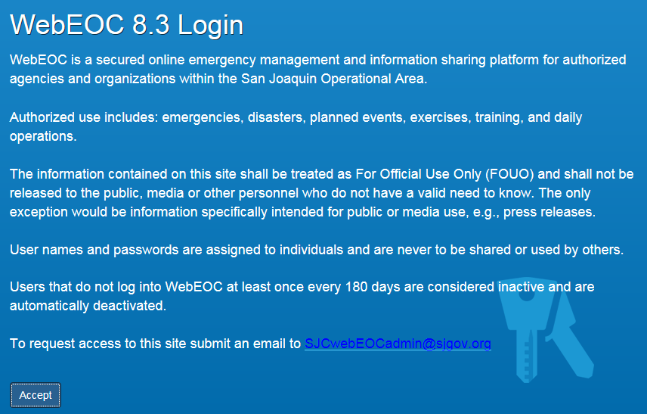
Visit the San Joaquin Operational Area
WebEOC Page For more information
https://www.sjgov.org/ems/webeocinfo.htm

Slide 19


Slide 20
San Joaquin County
Emergency Medical Services Agency
Control of Patient Dispersal
  During a single facility emergent evacuation San Joaquin General Hospital, acting as the Operational Area Disaster Control Facility, will determine all patient destinations other than movement to home settings.
  During single or multiple facility planned evacuations patient dispersal will be coordinated by the EMS Agency Duty Officer (Medical Health Operational Area Coordinator) in conjunction with the facility officials, and the Incident Commander(s).

Slide 21
San Joaquin County
Emergency Medical Services Agency
Mutual Aid
  Medical mutual aid requests will be coordinated by the Medical Health Operational Area Coordinator (MHOAC) in compliance with the Standardized Emergency Management System (SEMS) and the National Incident Management System (NIMS).

Slide 23
San Joaquin County
Emergency Medical Services Agency
Emergency Evacuation Destination Categories
  Each facility will prepare a list of patient/resident Emergency Evacuation Destination Categories, which indicate the level of care needed, types of facility, and types of transportation required for each patient/resident. See Form LTC 401
  Provide a copy to the Incident Commander

Slide 24
San Joaquin County
Emergency Medical Services Agency
Emergency Evacuation Destination Categories
  LEVEL I: Patients/residents are usually transferred from inpatient medical treatment facilities and require a level of care only available in hospital or Skilled Nursing or Sub-Acute Care Facilities. These patients/residents are transported by Advance Life Support (ALS) ambulances.

Slide 25
San Joaquin County
Emergency Medical Services Agency
Emergency Evacuation Destination Categories
  LEVEL II: Patients/residents have no acute medical conditions but require medical monitoring, treatment or personal care beyond what is available in home setting or public shelters. These patients/residents are transported by Basic Life Support (BLS) ambulances, wheel chair van, car, van or bus.

Slide 26
San Joaquin County
Emergency Medical Services Agency
Emergency Evacuation Destination Categories
  LEVEL III: Patients/residents are able to meet own needs or has reliable caretakers to assist with personal and/or medical care. These patients/residents are transported by car, van or bus.

Slide 27
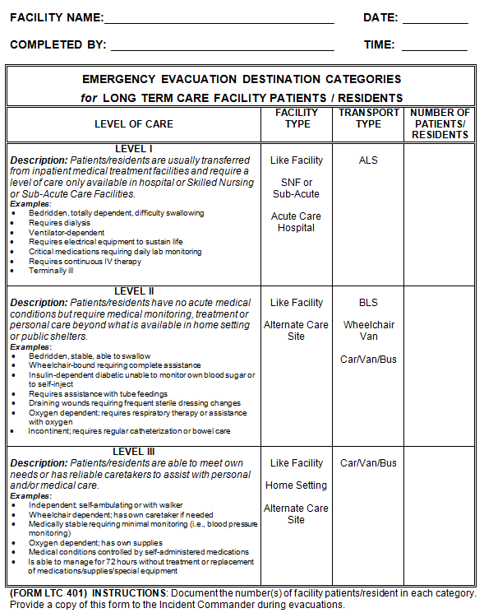
Form LTC 401
Enter the number of
Patients/Residents
in each Category
Best Darn Care In Town
6/27/17
Ima Gonatakecareofyou
1145
43
14
73

Slide 28
San Joaquin County
Emergency Medical Services Agency
Evacuation Status Categories
  During planned multiple facility evacuations field level response personnel, under the direction of the Incident Commander, will make contact with each Long Term Care Facility in the evacuation zone. Each facility will be evaluated on their ability to evacuate and placed into one of four Evacuation Status Categories. See Form LTC 402

Slide 29
San Joaquin County
Emergency Medical Services Agency
Evacuation Status Categories
  STATUS A: The facility has a destination identified for its patients/residents and can evacuate/transport without assistance from outside agencies
  STATUS B: The facility does not have a destination identified for its patients/residents but can evacuate/transport its residents without assistance from outside agencies if provided a destination.

Slide 30
San Joaquin County
Emergency Medical Services Agency
Evacuation Status Categories
  STATUS C: The facility has a destination identified for its patients/residents and only requires evacuation/transportation assistance from outside agencies.
  STATUS D: The facility does not have a destination identified for its patients/residents and requires evacuation/transportation assistance from outside agencies.

Slide 31
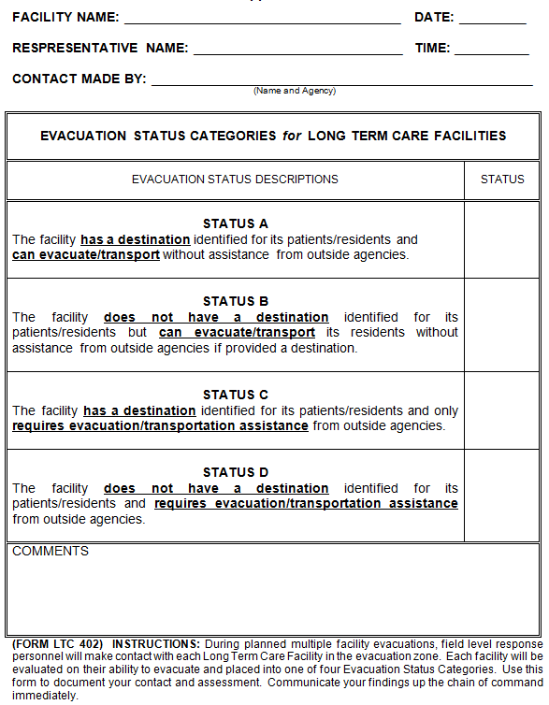
Best Darn Care In Town
6/27/17
Ima Gonatakecareofyou
1433
Form LTC 402
Enter the Evacuation
Status Category
Joe Rescue, City Fire Department
X
The facility can handle the evacuation on their own.
Will start transporting patients/residents by 1500 hours.

Slide 32
San Joaquin County
Emergency Medical Services Agency
Evacuation Procedures (Single & Multiple Facilities)
  Two Types of Evacuations:
    Emergent
    Planned

Slide 33
San Joaquin County
Emergency Medical Services Agency
Evacuation Procedures
  Emergent Evacuation
    An unplanned spontaneous movement of patients/residents out of the facility due to an immediate threat that renders the facility unsafe for occupancy.

Slide 34
San Joaquin County
Emergency Medical Services Agency
Evacuation Procedures
  Example of an Emergent Evacuation:
    A fire breaks out in the facility prompting the immediate evacuation of all patients/residents and staff. Property damage is severe and the facility is determined to be unsafe for occupancy. Patients/residents are transported to other facilities for care.

Slide 35
San Joaquin County
Emergency Medical Services Agency
Evacuation Procedures
  Planned Evacuation
    A planned evacuation is defined as a situation where the threat to the facility is not immediate and time is available to conduct orderly patient/resident movement. Patients/residents can remain within the facility without danger to their well being for a limited amount of time until relocation arrangements are made.

Slide 36
San Joaquin County
Emergency Medical Services Agency
Evacuation Procedures
  Example of a Planned Evacuation:
    A facility experiences an air conditioning system failure at 6:00 AM. Temperatures are forecasted to reach a high of 110 degrees by 4:30 PM. Facility officials determine that if they are unable to repair the air conditioning system in time they will need to evacuate patients/residents to another facility. Adequate time is available to make arrangements for patients/residents to be moved to other facilities in the area.

Slide 37
San Joaquin County
Emergency Medical Services Agency
Event Occurs
Must Evacuate Immediately?
No
Yes
Planned Evacuation
Emergent Evacuation

Slide 38
San Joaquin County
Emergency Medical Services Agency
Evacuation Procedures
  Emergent Notifications:
    Facility Notifies
      9-1-1
      Once it is assured that all patients/residents have been removed from harm’s way, the evacuating facility is responsible to notify applicable State and county authorities.

Slide 39
San Joaquin County
Emergency Medical Services Agency
Evacuation Procedures
  Emergent Notifications
    State Licensing Authorities:
      California Department of Public Health Licensing & Certification
    County Authorities:
      EMS Agency Duty Officer
      Public Health Services
      Human Services Agency Ombudsman

Slide 40
San Joaquin County
Emergency Medical Services Agency
Evacuation Procedures
  Emergent Notifications:
    Medical Group or Patient Transportation Group Supervisor notifies:
      Disaster Control Facility – San Joaquin General Hospital

Slide 41
San Joaquin County
Emergency Medical Services Agency
Evacuation Procedures
  Emergent Notifications:
    Disaster Control Facility (DCF) notifies:
      Acute Care Hospitals
      EMS Agency Duty Officer
    Acute Care Hospitals notifies:
      Designated Skilled Nursing Facilities

Slide 42
San Joaquin County
Emergency Medical Services Agency
Disaster Control Facility/Acute Care Hospital - Skilled Nursing Facility Evacuation Procedures
  The Disaster Control Facility will contact all acute care hospitals in San Joaquin County.
  Each hospital Emergency Department will be notified by the Disaster Control Facility of the evacuation by EMSystem® and/or MCI “Blast Phone”.
  Each acute care hospital will contact their assigned Skilled Nursing Facilities and obtain the number of patients/residents each can accept.

Slide 43
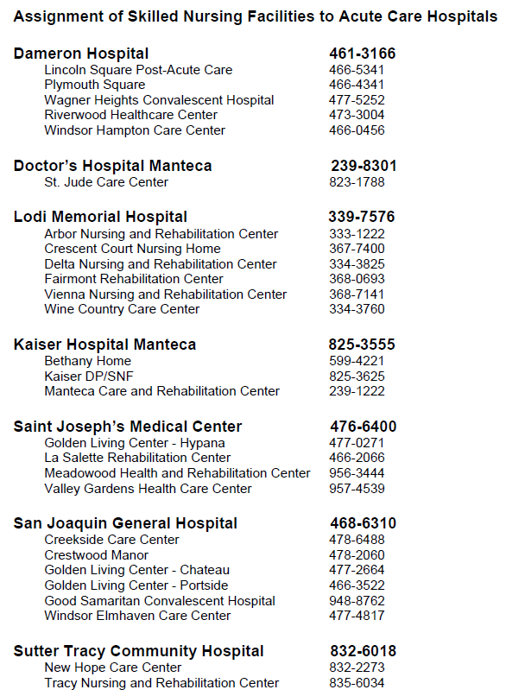

Slide 44
San Joaquin County
Emergency Medical Services Agency
Disaster Control Facility/Acute Care Hospital - Skilled Nursing Facility Evacuation Procedures
  The hospitals will report back to the Disaster Control Facility, on the MCI “Blast Phone”, the number(s) of patients/residents each of their assigned Skilled Nursing Facilities can accept.
  The DCF will instruct the Medical Group Supervisor, or Patient Transportation Group Supervisor if assigned, where to take each patient/resident.

Slide 45
San Joaquin County
Emergency Medical Services Agency
Disaster Control Facility/Acute Care Hospital - Skilled Nursing Facility Evacuation Procedures
  The DCF will track the number of patients/residents transported to each destination.
  The Patient Transportation Group Supervisor and facility personnel share the responsibility for tracking the name(s) and destination(s) of each patient/resident.

Slide 46
San Joaquin County
Emergency Medical Services Agency
Evacuation Procedures
  Emergent Patient Movement:
    Patients/residents will be evacuated to the closest safe area outside of the facility, e.g. parking lot, lawns, or other buildings, in accordance with the facility’s Emergency Operations Plan.
    The Disaster Control Facility will be contacted for final patient/resident destination decisions, other than movement to a home setting. Contact with the Disaster Control Facility will be made by the Medical Group Supervisor or Patient Transportation Group Supervisor. See Form LTC 403

Slide 47
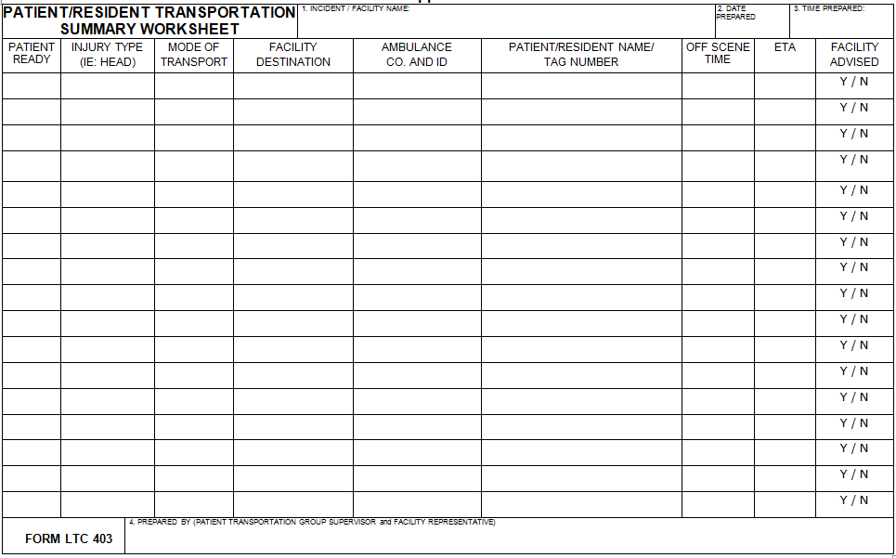
Best Darn Care In Town
6/27/17
Yes
N/A
BLS
XYZ Care
Medic 20
S. Huffman, #12345678
1518
1542
Les Movemout (PTGS) and Will Keeptrackofthem (Facility Rep)

Slide 48
San Joaquin County
Emergency Medical Services Agency
Evacuation Procedures
  Emergent Patient Movement:
    The county designated EMS dispatch center is the single point of contact for all EMS and transportation resources. Suitable transportation will be determined by the Medical Group Supervisor, e.g. ambulance, wheel chair van, bus or other.

Slide 49
San Joaquin County
Emergency Medical Services Agency
Evacuation Procedures
  Planned Evacuation Notifications:
    Facility Notifies
      EMS Agency Duty Officer
      Applicable State and county authorities

Slide 50
San Joaquin County
Emergency Medical Services Agency
Evacuation Procedures
  Planned Evacuation Notifications:
    EMS Agency Duty Officer notifies:
      Local fire and law enforcement
      Other outside agencies and organizations as needed (Public Health Services, Ambulance providers, OES, etc.)

Slide 51
San Joaquin County
Emergency Medical Services Agency
Evacuation Procedures
  Planned Patient Movement:
    The evacuating facility will implement its Emergency Operations Plan. The senior facility administrator will remain available to work with the responding EMS Agency Duty Officer to form a Unified Command. The facility administrator working as part of the Unified Command must have the authority to evacuate the facility and make time critical financial decisions.

Slide 52
San Joaquin County
Emergency Medical Services Agency
Evacuation Procedures
  Planned Patient Movement:
    There will be three destination options for patient/resident movement:
      Home Setting
      Like Facility
      Alternate Care Site

Slide 53
San Joaquin County
Emergency Medical Services Agency
Evacuation Procedures
  Planned Patient Movement:
    Alternate Care Site
    In this case, staff from the evacuating facility will accompany and stay with patients/residents in the Alternate Care Site
ACS

Slide 54
San Joaquin County
Emergency Medical Services Agency
Evacuation Procedures
  Medical Control (Planned Evacuations):
    The patient’s or resident’s physician will continue to render care to their patient. The receiving facility will notify physicians of the temporary transfer of patients to the new facility.

Slide 55
San Joaquin County
Emergency Medical Services Agency
Evacuation Procedures
  Planned Evacuation Medical Control:
    The evacuating facility is responsible for ensuring that all patients are moved with the following items physically with them:
      Pertinent Personal and Medical information
      Name of patient’s or resident’s physician and telephone number
      Resident Identification (Arm Band or Disaster Tag)
      Medications for a minimum of seventy-two hours
      Change of clothes

Slide 56
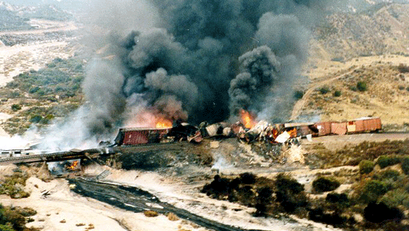
San Joaquin County
Emergency Medical Services Agency
Evacuation Procedures
  Shelter-In-Place
    Patients/residents remain indoors and are moved to a safe refuge area within the facility. Windows and doors are closed and the ventilation system closed to outside air.

Slide 57
San Joaquin County
Emergency Medical Services Agency
Evacuation Procedures
  Shelter-In-Place
    Example: A train derailment occurs two miles upwind from the facility. One of the railcars, containing 180,000 pound of chlorine (a toxic gas), is leaking. Emergency personnel on scene estimate that the toxic gas will travel approximately five miles downwind, and advises the Incident Commander to issue a shelter-in-place order for all downwind residents and businesses within five miles of the release.

Slide 58
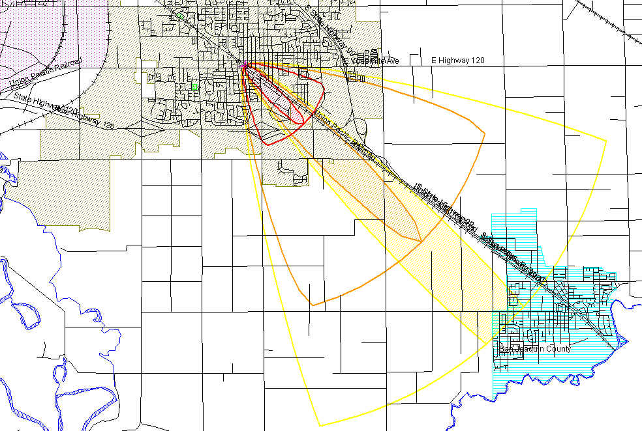
San Joaquin County
Emergency Medical Services Agency
Evacuation Procedures
  Shelter-In-Place (Chlorine Railcar Release)

Slide 59
X
Shelter-In-Place
Checklist
X
X
Administration Office
X
North Engine Room
X
Administration Office
X
Engineering

Slide 60
San Joaquin County
Emergency Medical Services Agency
Evacuation Procedures – Multiple Facilities
  In the event that more than one facility must be evacuated due to threatening conditions affecting a large geographic area, these procedures will become the guide for response and evacuation operations.
  The procedures of the single facility evacuation will only remain operative to the extent that they conform to these procedures.

Slide 61
San Joaquin County
Emergency Medical Services Agency
Evacuation Procedures – Multiple Facilities
  The most likely events that could require the nearly simultaneous evacuation of multiple facilities are as follows:
    A flood or threatened flood within a geographic area of the county.
    Extended loss of critical utilities over a large area that presents a health risk to patients/residents in more than one facility.
    A major earthquake that creates the extended loss of critical utilities as discussed in item 2 above, and/or renders multiple facilities unsafe for occupancy due to structural damage.

Slide 63
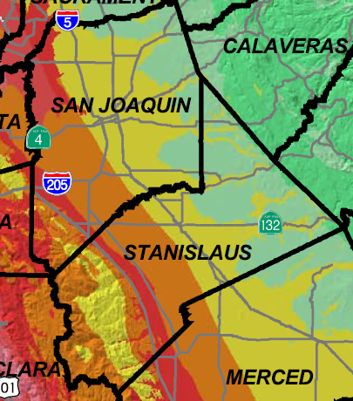
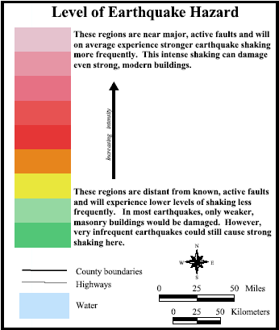
Source: California Shake Map
State of California, Spring 2003

Slide 64
San Joaquin County
Emergency Medical Services Agency
Evacuation Procedures – Multiple Facilities
  Example: A nearby river has been at flood stage and is now forecasted to reach danger stage within twenty-four hours, creating a significant risk of a levee failure and widespread flooding. Government officials have issued an evacuation order for the area of greatest risk. The evacuation area includes a mixture of residential and commercial property, as well as five Long Term Care Facilities.

Slide 65
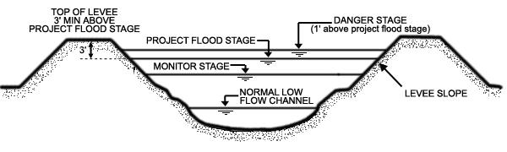
San Joaquin County
Emergency Medical Services Agency
River Stages

Slide 66
San Joaquin County
Emergency Medical Services Agency
Evacuation Procedures
  Multiple Facility Emergent Evacuation Notifications:
    In addition the EMS Duty Officer will send out a California Health Alert Network (CAHAN) Alert to all Long Term Care Facilities in the county notifying them of the emergent evacuation and requesting information on how many patients/residents they are able to receive.
    To request a CAHAN user account email your request to sjc-cahan@sjcphs.org

Slide 67
San Joaquin County
Emergency Medical Services Agency
Command and Control
  Upon activation of this plan, the EMS Agency Administrator and the Public Health Officer may establish the Medical/Health Branch at the Operational Area Emergency Operations Center (EOC), or in close communications with the Operational Area EOC, to perform functions identified in this plan.
  The Medical/Health Branch will work with elements of the community medical system as well as city, regional, and State officials to coordinate and control operations affecting community medical and Long Term Care Facilities.

Slide 68
San Joaquin County
Emergency Medical Services Agency
Facility Contact & Evacuation Capability Assessment
  Affected jurisdictions will identify which Evacuation Zones are affected by the evacuation order
  The public safety Incident Commander(s) will manage the evacuation within their jurisdiction(s).

Slide 69
San Joaquin County
Emergency Medical Services Agency
Facility Contact & Evacuation Capability Assessment
  Evacuation Maps have been prepared for each Evacuation Zone and contain lists of known critical facilities, including Long Term Care Facilities.
    http://www.sjmap.org/evacmaps/

Slide 70
San Joaquin County
Emergency Medical Services Agency
Facility Contact & Evacuation Capability Assessment
  The Incident Commander will use these lists to ensure that contact is made with each Long Term Care Facility listed for the following purposes:
    Ensure that the facility has received the evacuation order.
    Assess the facility’s ability to carry out the evacuation order. This assessment will place the facility in one of four Evacuation Status Categories (A to D). See Form LTC 402

Slide 71
Best Darn Care In Town
6/27/17
11/1/07
Ima Gonatakecareofyou
1433
1433
Form LTC 402
Enter the Evacuation
Status Category
Joe Rescue, City Fire Department
X
GOOD
BAD
The facility can handle the evacuation on their own.
Will start transporting patients/residents by 1500 hours.

Slide 72

San Joaquin County
Emergency Medical Services Agency
Summary
  Evacuation Flowchart
  Facility Evacuation Checklist

Slide 73
San Joaquin County
Emergency Medical Services Agency
Event Occurs
Must Evacuate Immediately?
No
Yes
Planned Evacuation
Emergent Evacuation

Slide 77
San Joaquin County
Emergency Medical Services Agency
A Keep It Simple Tip!
  Keep extra copies of the Evacuation Flowchart and Facility Evacuation Checklist on a clipboard for easy access.
  Keep extra copies of the forms on a clipboard; especially the Emergency Evacuation Destination Categories Form (LTC 401)

Slide 78
San Joaquin County
Emergency Medical Services Agency
Questions?

