Slide 1

This is one in a series of presentations intended to teach healthcare professionals, volunteers and others how to operate pre-programmed Amateur Radio equipment found at healthcare facilities in San Joaquin County.
It is intended to provide basic “how-to” information and is not a full course in radio operation.
This presentation was provided by the San Joaquin County Emergency Medical Services Agency for the members of the San Joaquin Operational Area Healthcare Coalition. Funding was provided by the 2012/13 Hospital Preparedness Program (HPP) Grant.
Models covered: VX-170, FT-270, FT-60, TM-V7A, TM-G707, TM-D710A.
TM-V7A
Notes:
This is one in a series of presentations intended to teach healthcare professionals, volunteers and others how to operate the pre-programmed Amateur Radio equipment provided by the San Joaquin County EMS Agency.
It is intended to provide basic “how-to” information and is not a full course in radio operation.

Slide 2

Radio
OPERATION
How to operate your facility’s
ham radio equipment
Notes:
Welcome to this Radio Operation course. It’s purpose is to teach you how to operate the Amateur Radio equipment located at your healthcare facility. This course takes less than 11 minutes to complete. It is intended for both pre-need and just-in-time radio training.

Slide 3
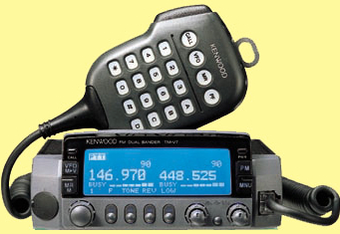
Kenwood tm-V7A
Dual Band Amateur Radio Transmitter/Receiver (VHF/UHF)
Notes:
This presentation covers the Kenwood TM-V7A Amateur Radio Transceiver. This is a dual-band transmitter-receiver, or transceiver, that operates on VHF and UHF Amateur Radio frequencies.

Slide 4
objectives
Familiarize you with operating the radio.
Provide a just-in-time training deck to refer to.
Improved/easier communication
Three tasks:
Turning radio on and off
Setting controls and selecting channels
Talking on the correct channel
Notes:
This course will familiarize you with the most basic functions of the Amateur Radio equipment.
You will learn only the essential controls necessary to operate the radio. This includes how to turn the radio on and-off, how to set the volume and squelch controls and how to select the left or right side of the radio for transmitting.
You will also learn how to select the proper memory channel for use during an exercise or actual emergency.

Slide 5
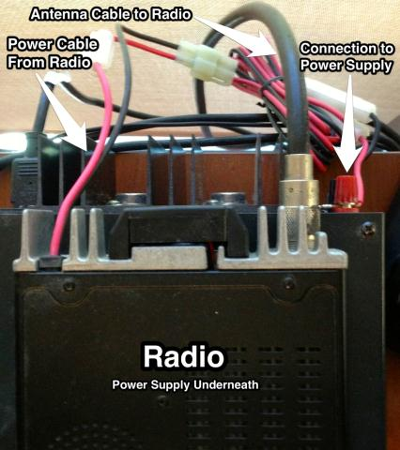
Check the radio
Is there an antenna attached to the radio?
Is the power supply connected to the radio?
Is the power supply connected to the wall?
Notes:
Step One is to make sure the radio is ready for use.
Look at the back of the radio to make sure an antenna cable is attached to the antenna connector on the radio. Operating the radio without an antenna attached will not allow you to transmit and is likely to destroy the transmitter.
Make sure the radio is connected to the power supply and the power supply is connected to a wall outlet.

Slide 6
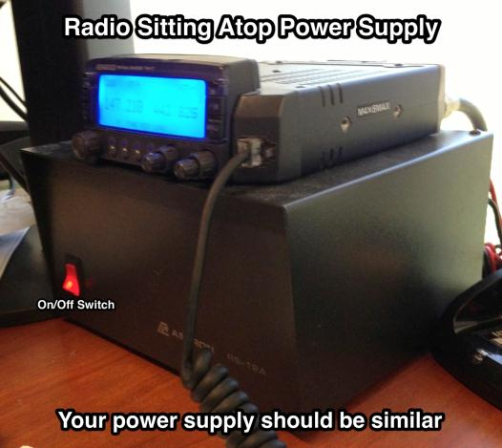
Turn on power Supply
The power supply should be connected to a wall outlet and to the radio.
Use the switch on the power supply to turn it on. The switch may light up.
Notes:
Your radio requires 12-volt DC power to operate. It is provided by a separate a power supply usually located near the radio.
When the power supply is on, its on/off switch may be lit.
If you want to follow along and the power supply Is not already on, press the switch on the front panel to turn on the power supply on at this time.
The power supply should be turned off when the radio is not in use.
Right now, the power supply should be on.

Slide 7
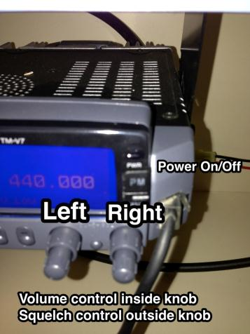
PREPARING TO turn THE radio on
The TM-V7A radio has two separate receivers and is capable of listening to two channels at once and to transmit on the channel of the user’s choice.
This can cause confusion.
You must select which side of the radio to transmit on.
The left side of the radio contains VHF channels. This is what we normally use. The right side of the radio contains UHF channels.
Notes:
This radio has two separate receivers and this can cause confusion.
There is a left receiver and a right receiver and you can listen to both at the same time, which is why there are separate left and right volume and squelch controls.
You must select the transmit band before transmitting – either the left side or the right side.
We normally use only the left side of the radio.

Slide 8
How to turn radio on
Press the On/Off key to turn the radio on.
Set the left volume and squelch controls to the 9-o’clock position.
Set the right volume control fully counter-clockwise (off).
Notes:
Next, we will adjust the radio and then turn it on.
There are two important controls. The volume control behaves and you’d expect and controls the sound. The squelch control quiets static when there is no signal present.
Now, find the volume and squelch knobs and turn the LEFT volume and squelch controls to the each to the 9 o’clock position. This sets the volume and squelch on the left side of he radio.
Next, turn the RIGHT volume control fully counter-clockwise. The RIGHT squelch control should be turned fully clockwise. These settings silence the right side of the radio.
With the volume and squelch adjusted, press the power on/off button. The radio display should now light. If it does not, check the power supply and make sure it is turned on.

Slide 9
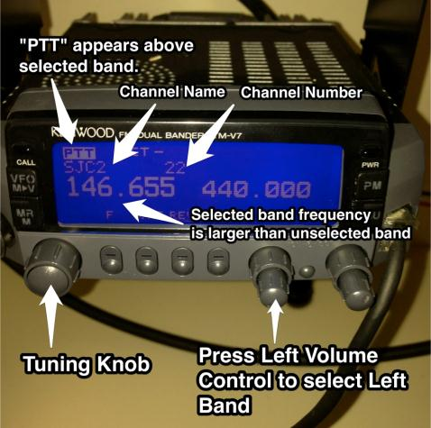
Select the left band
Select the Left Band (VHF) by pressing the Left volume control knob.
The PTT icon appears above the transmit band.
Notes:
Select the left band by pressing the left volume control knob.
Note that the PTT icon lights up on the slide that is set to transmit. This should be the left band.
PTT stands for “push-to-talk” and again designated the band or side of the radio you will transmit on.

Slide 10
MEMORY MODE
VS. VFO MODE
The radio has two tuning modes. VFO MODE is used to change frequency only. Numbers appear on the display in VFO MODE and increase or decrease as you turn the tuning knob.
In MEMORY MODE there is a channel name on the display AND the tuning knob changes the channel name on the display. We use MEMORY MODE only.
Notes:
There are two ways to select the frequency you will use. One is a traditional tuner, called VFO mode, that changes frequency as you turn the tuning control knob.
This is much the same as selecting a new frequency by turning the dial on your automobile radio. It’s call VFO mode.
The radio also contains pre-programmed memory channels, each of which has its own channel number and name.

Slide 11
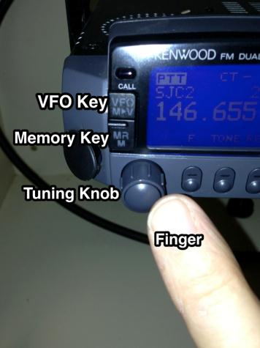
How to Select memory mode
The radio has two ways to select a channel: VFO Mode and Memory Mode.
Select Memory Mode by pressing the MR key.
In Memory Mode, the radio will display the channel name and memory channel number. Turning the tuning knob changes channels.
Notes:
Use the MR key to select MEMORY MODE on the radio. This is very important and is often a cause of confusion. To select memory mode, press the MR button in the radio. This should cause a channel name and memory channel number to appear on the display.

Slide 12
How MEMORY channels work
Every health care facility radio is programmed alike. The memory channels are the same in all of them. Each memory channel has a name as well as a channel number, always the same on all radios.
Memory channels 21-50 are programmed into your radio and are the ONLY memory channels we use for emergency communications.
Each channel also has a name:
SJC1 – SJC15 are in Memory Channels 21-36. These are the main channels for our county. Each is a different repeater and most cover the entire county when used at your facility.
The other channels may be used in specific circumstances and you will be directed use them when appropriate.
Notes:
We use Memory Channels to make it easier to find the proper channel to use.
Without Memory Channels, there are thousands of frequencies on which communication might be taking place.
With Memory Channels, we have preprogrammed your radio with all the channels we might use during an emergency. These are the same channels used during drills and exercise or for normal Amateur Radio communication.
Each Memory Channel has both a number and a name.
The names may not make any sense to you. They are tactical names, selected for use in an organized and widely used plan such as ours. The primary channels we use are SJC1 through SJC15.

Slide 13
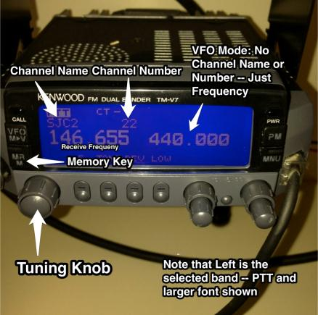
ONLY USE memory mode
If the radio is in VFO Mode, return to Memory Mode by pressing the MR key. This is what the Memory Mode display looks like (left).
The Tuning knob is used to change memory channels.
In VFO mode, no Channel Name or Memory Channel Number appears on the display (right).
In VFO mode the display shows frequency numbers that increase or decrease when the tuning knob is rotated. Do not use VFO mode.
Notes:
Getting the radio onto the proper channel is the biggest challenge facing most users. You must the on the same channel as everyone you wish to communicate with.
All health care facility radios have been pre-programmed with the Amateur Radio channels used in San Joaquin County.
All of the facility radios are programmed alike. Many personally-owned radios are also programmed using this channel plan.
If you own an Amateur Radio, we can arrange to program it so it matches all these other radios, making it easier to use.
You should only use memory mode, as described here. Note that memory mode shows a channel name and memory channel number on the display. In VFO mode, only a frequency number is displayed, as shown here.

Slide 14
How to Select a MEMORY channel
In Memory Mode, channels are selected by turning the tuning knob. Clockwise increases the channel number while counter-clockwise rotation decreases the channel number.
Our PRIMARY CHANNEL is Channel 22, labeled SJC2. This is where our scheduled drills and exercises take place unless you are notified otherwise.
Our BACKUP CHANNEL is Channel 24, labeled SJC4. We use Channel 23, labeled SJC3 and Channel 21, labeled SJC1 as our additional backup channels.
If you don’t hear Net Control on Channel 22 SJC2, try the other two channels and switch back-and-forth until you find us. In a major emergency, we may be on another channel. Listen for Net Control using the call sign K6EMS.
Notes:
In Memory Mode, channels are selected by rotating the tuning knob. Clockwise rotation moves to a higher-numbered channel while counter-clockwise rotation moves the radio to a lower-numbered channel.
It is now time to select the proper channel for use.
Most of the time, we use Channel 22/SJC2, for our operations. This includes emergency, non-emergency, drills and exercises. If in doubt, always start on Channel 22/SJC2. If Channel 22/SJC2 is unavailable or fails while we are using it, we will immediately switch to Channel 24/SJC4. Our second backup channel is Channel 23/SJC3.

Slide 15
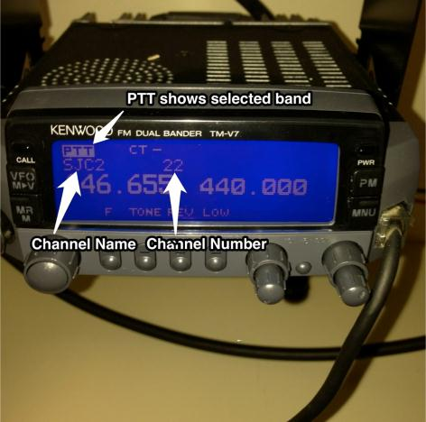
READY TO COMMUNICATE
This is what the radio looks like when set to SJC2 Channel 22 and is ready to communicate.
Verify that the PTT icon is above the left channel name.
Notes:
This is what the radio looks like when properly adjusted and set to memory channel 22, SJC2, which is our primary channel.
Note than the PTT icon appears on the left side of the radio, showing that we are ready to transmit on our selected channel.

Slide 16
HOW TO Communicate
USE PLAIN LANGUAGE and if you don’t understand something, ASK. No “radio talk” during emergencies or our drills.
When one station finishes speaking and releases the push-to-talk switch (on the side of the microphone), you will usually hear some sort of “beep” called a courtesy tone. That indicates the other station has completed its transmission.
The best way to learn is by listening.
Don’t be “mic shy.” Hams are a friendly group and want to talk to you. Mistakes are expected.
SJC2/Channel 22 (“The Tracy Repeater”) is a good place to start.
Notes:
Here are some tips for using Amateur Radio:
USE PLAIN LANGUAGE and if you don’t understand something, ASK.
No “radio talk” during emergencies or our drills.
When one station finishes speaking and releases the push-to-talk switch, you will usually hear some sort of “beep” called a courtesy tone. That indicates the other station has completed its transmission.
The best way to learn is by listening.
Don’t be “mic shy.” Hams are a friendly group and want to talk to you. Mistakes are expected.
SJC2 (“The Tracy Repeater”) is a good place to start.

Slide 17
If something goes wrong
If the power supply does not turn on, it’s either the cord is unplugged or the fuse has blown.
If the radio does not turn on, it’s probably the power supply is off or the radio was not turned on properly.
Radio is on, but no sound the volume control may be too low.
If you hear continuous static, adjust the squelch control.
You might find yourself on the wrong channel.
Need help? Ask another ham or call for assistance.
Notes:
If the power supply does not turn on, it’s either the cord is unplugged or the fuse has blown.
If the radio does not turn on, it’s probably the power supply is off or the radio was not turned on properly.
If the radio is on, but there is no sound the volume control may be too low. If there is continuous static adjust the squelch control.
You might find yourself on the wrong channel, so check that.
Need help? Ask another ham or call for assistance.

Slide 18
What to do:
Turn power supply on.
Press PWR to turn radio on.
Press MR to confirm Memory mode.
Press the left Volume Control knob to select the left band.
Use the Tuning knob to select a channel.
6. Channel 22 SJC2 is our primary channel.
7. Channel 24 SJC4 is our backup channel.
8. Channels 23 SJC3 and 21 SJC1 are the alternates.
Notes:
Here is a summary of what we’ve learned from this presentation. These are the most important eight points. Obviously, the radio must be on and doing that requires the power supply being turned on first. You must be in Memory Mode – where you see channel names and channel numbers rather than frequencies. In Memory Mode, select the proper channel. Usually, this will be Channel 22, named SJC2, but other channels may be used instead.

Slide 19
Ham radio is fun
Amateur Radio is not just for emergencies. You are licensed to talk anytime, all over the world.
There are Amateur Radio clubs in San Joaquin County.
There are non-emergency training nets every week.
Learn more:
n5fdl.com for general SJC information
hamcram.org for licensing and upgrade information
arrl.org for all about ham radio
Notes:
Amateur Radio is not just for emergency communications.
In fact, emergencies are one of the smaller activities involving Amateur Radio.
Your ham license opens up a world of activities, including talking around the world, talking to orbiting satellites and to the International Space Station. There are weekly radio contest. You can also try do-it-yourself projects and many other fun activities.
There are four Amateur Radio clubs in San Joaquin county and each holds an on-the-air training net each week that you’re invited to participate in. For more information, visit n5fdl.com for details.

Slide 20
Questions?
For additional information, please contact:
David Coursey N5FDL david@cevol.org 209-740-7515
Phil Cook KI6OAG (SJC EMS) pcook@sjgov.org
209-468-6818
Notes:
Thank you for your interest in this presentation. If you have any questions about the content or comments about the presentation, please contact us.

