Slide 1

This is one in a series of presentations intended to teach healthcare professionals, volunteers and others how to operate pre-programmed Amateur Radio equipment found at healthcare facilities in San Joaquin County.
It is intended to provide basic “how-to” information and is not a full course in radio operation.
This presentation was provided by the San Joaquin County Emergency Medical Services Agency for the members of the San Joaquin Operational Area Healthcare Coalition. Funding was provided by the 2012/13 Hospital Preparedness Program (HPP) Grant.
Models covered: VX-170, FT-270, FT-60, TM-V7A, TM-G707, TM-D710A.
Notes:
This is one in a series of presentations intended to teach health care professionals, volunteers and others how to operate pre-programmed Amateur Radio equipment provided by the San Joaquin County EMS Agency.
It is intended to provide basic “how-to” information and is not a full course in radio operation.
Models covered: VX-170, FT-270, FT-60, TM-V7A, TM-G707, TM-D710A.

Slide 2

Radio
OPERATION
How to operate your facility’s
ham radio equipment
Notes:
Welcome to this Radio Operation course. It’s purpose is to teach you how to operate the Amateur Radio equipment that you will be using at your healthcare facility. This course takes less than 10 minutes to complete and is intended for pre-need and just-in-time radio training.

Slide 3
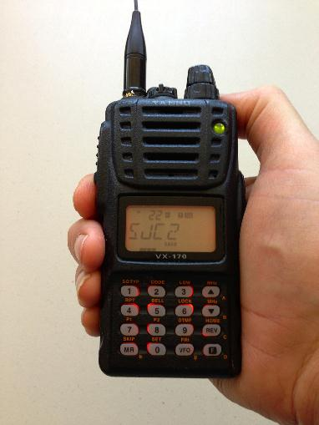
Yaesu vx-170
Handheld Amateur Radio VHF Transmitter/Receiver
Notes:
This presentation covers the Yaesu VX-170 portable VHF transmitter-receiver. This transceiver is common in San Joaquin County and until recently was our recommended radio. The San Joaquin County EMS Agency owns 15 of these handie-talkie radios and we often use them for training events. If you are interested in purchasing a radio for your facility or for personal use, please contact us before making a purchase.

Slide 4
objectives
Familiarize you with operating the radio.
Provide you a “just-in-time” training slide deck to refer to.
Improved/easier communication
Three tasks:
Turning radio on and off
Setting controls and selecting channels
Talking on the correct channel
Notes:
This course will familiarize you with the basic functions of the Amateur Radio equipment we use.
You will learn only the essential controls necessary to operate the radio equipment. You will learn how to turn the radio on-and-off-on, how to set the volume and squelch controls and how to select the proper memory channel for use during an exercise or actual emergency.

Slide 5
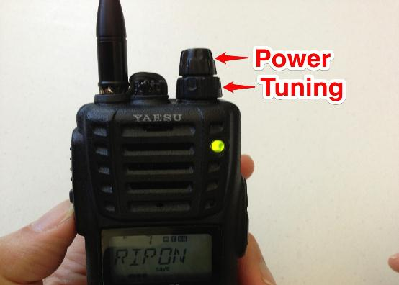
How to turn on the radio
The Power Knob is inside the Tuning knob.
Battery Voltage appears.
Tones are heard and used to set volume.
The word “Memory” may appear.
Notes:
The power and tuning controls are knobs located on the top of the radio.
The upper or inside knob controls power and audio volume. The lower or outer knob is used for tuning.
When the radio is first turned on, the battery voltage is displayed.
If the radio is in memory mode the word memory also appears.
You will hear as series of three rising tones that are used to set the volume control to a comfortable level. If you have a radio, turn it on at this time.

Slide 6
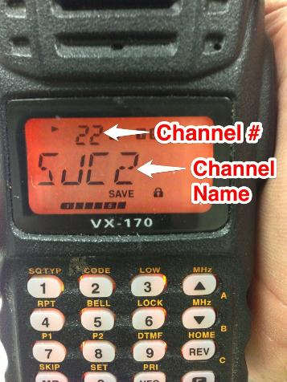
MEMORY MODE
The radio has two tuning modes. In MEMORY MODE there is a channel name and number on the display.
Tuning knob changes the channel name and number.
We only use MEMORY MODE.
Notes:
Here is a topic that sometimes confuses people. It is also very important. There are two ways to tune your radio. The first is MEMORY MODE, as shown here. In memory mode, you select from channels already programmed into your radio. We only use memory channels to tune our radios. You will recognize a memory channel because a channel name appears -- usually a group of letters and a number. The memory channel number appears above the channel name.

Slide 7
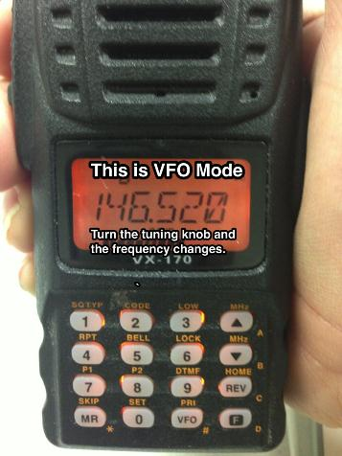
VFO MODE
VFO MODE is used to change frequency only.
Numbers appear on the display in VFO MODE and increase or decrease as you turn the tuning knob.
We do not use VFO MODE, only MEMORY MODE.
Notes:
The other method is tuning by by frequency, much as you might do in your automobile where you are looking for a station.
Tuning by frequency in Amateur Radio is called VFO mode.
As shown here, if you are in VFO mode and turn the tuning knob, the frequency increases or decreases. There are no words that appear on the screen.
We do not normally use VFO mode and it is shown here so that you will recognize it should you get into VFO mode by accident.

Slide 8
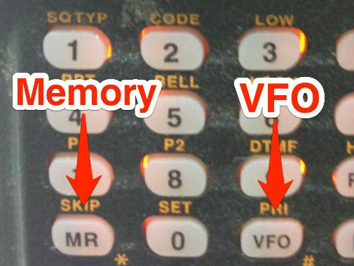
How to Select memory mode
Press the MR key to select MEMORY MODE.
Don’t press the VFO key.
Notes:
Here is how we select MEMORY MODE on the radio.
This is only necessary if your radio is in VFO mode and is showing a frequency instead of a memory channel name and channel number on the display.
To select memory mode, press the MR button on the radio keypad. This should cause a channel name and memory channel number to appear on the display. If it does not, press the MR key a second time.
VFO mode is accessed using the VFO key. Don’t do this. If you do by mistake, press the MR key to return to memory mode.
If your radio does not respond to pressing the keys, it is probably locked. More on locking and unlocking your radio later in this presentation.

Slide 9
How MEMORY channels work
Every hospital radio is programmed alike. The memory channels are the same in all of them. Each memory channel has a name as well as a channel number, always the same on all radios.
Memory channels 21-50 are programmed into your radio and are the ONLY memory channels we use for emergency communications. Not all of the channels will be programmed.
Each channel also has a name:
SJC1 – SJC15 are in Memory Channels 21-35. These are the main channels for our county. Each is a different repeater and most cover the entire county when used at your facility.
The other channels may be used in specific circumstances and you will be directed use them when appropriate.
Download a frequency list at n5fdl.com.
Notes:
We use Memory Channels to make it easier to find the proper channel to use.
Without Memory Channels, there are thousands of frequencies on which communication might be taking place. With Memory Channels, we have preprogrammed your radio with all the channels we might use during an emergency. These are the same channels we used during drills and exercises or for normal everyday Amateur Radio communication.
Each Memory Channel has both a number and a name.
The names may not make any sense to you. They are tactical names, part of an organized and widely used emergency communications frequency plan.
The primary channels we use are named SJC1 through SJC15. The SJC naming scheme allows all operators to know we are using the San Joaquin County frequency plan. Each of the SJC channels, numbered 1-15, is represents a repeater system used for long-distance communication in San Joaquin County and beyond.

Slide 10
How to Select a MEMORY channel
In Memory Mode, channels are selected by turning the tuning knob. Clockwise increases the channel number while counter-clockwise rotation decreases the channel number.
Our PRIMARY CHANNEL is Channel 22, labeled SJC2. This is where our scheduled drills and exercises take place unless you are notified otherwise.
Our BACKUP CHANNEL is Channel 24, labeled SJC4. We use Channel 23, labeled SJC3 and Channel 21, labeled SJC1 as our additional backup channels.
If you don’t hear Net Control on Channel 22 SJC2, try the other two channels and switch back-and-forth until you find us. In a major emergency, we may be on another channel. Listen for Net Control using the call sign K6EMS.
Notes:
In Memory Mode, channels are selected by rotating the tuning knob. Clockwise rotation moves to a higher-numbered channel while counter-clockwise rotation moves the radio to a lower-numbered channel.
It is now time to select the proper channel for use.
Most of the time, we use Channel 22/SJC2, for our operations. This includes emergency, non-emergency, drills and exercises. If in doubt, always start on Channel 22/SJC2. If Channel 22/SJC2 is unavailable or fails while we are using it, we will immediately switch to Channel 24/SJC4. Our second backup channel is Channel 23/SJC3.

Slide 11
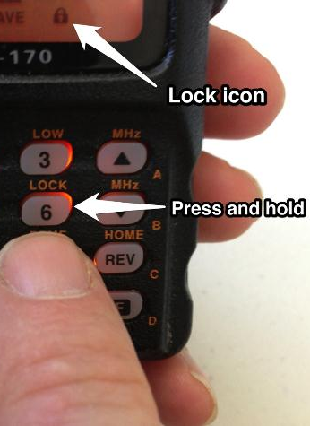
How to
LOCK THE RADIO
Locking the radio prevents accidental changes.
Lock the radio by holding the “6” key until the lock icon appears.
Unlock the radio by holding the “6” key until the lock icon disappears.
Notes:
A locked radio is a happy radio.
That’s because with the radio locked, none of the controls can be changed, except the volume control.
That means you won’t accidentally change the channel, shift into VFO mode or turn on the dreaded WIRES mode, covered in the next slide.
Lock your radio by pressing and holding the “6” key on the keypad until a small lock icon appears on the bottom the the display.
Unlock the radio by pressing and holding the “6” key until the lock icon disappears.

Slide 12
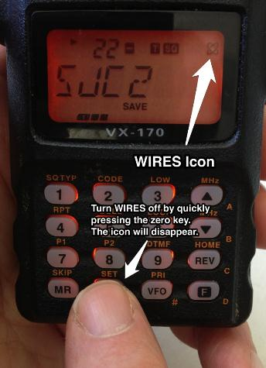
WIRES Warning
Yaesu radios have a feature that can cause trouble. It is called WIRES and is supposed to be used to link radios together.
More often it causes problems.
If someone says your first words are cut off, that they hear a touchtone before you speak or that “you have WIRES turned on” then turn it off.
WIRES is turned on and off by a quick press of the zero key. Notice the WIRES icon when turned on.
Lock radio to present accidents!
Notes:
Yaesu radios suffer from a well-meaning but poorly-executed feature called WIRES, the name of a radio linking system that failed in the marketplace.
WIRES should never be turned on.
If it is, people will probably complain that the first several words of your transmission are being cut off. You may be told that a Touchtone is being transmitted.
Those are the warning signs that should make you check your display for the WIRES icon. The atomic-looking icon made from two interlocking circles only shows when WIRES is enabled.
You can disable WIRES with a quick press of the zero key. The best way to keep WIRES turned off is to lock your radio.

Slide 13
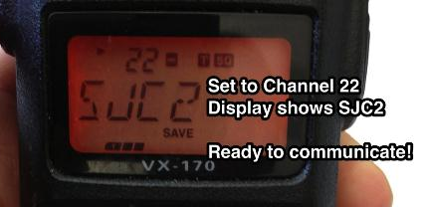
READY TO COMMUNICATE
This radio is ready to transmit on Channel 22 SJC2 except for one thing: It isn’t locked. Press and hold the “6” key to lock the radio.
To transmit:
Press and hold the push-to-talk switch on the side of the the radio. Release the push-to-talk switch to listen.
Wait two seconds before speaking to avoid being cut-off.
Hold the microphone about two inches away from your mouth. Talk across the microphone – not directly into it.
Speak in a normal tone of voice.
Notes:
This is what the radio looks like when properly adjusted and set to memory channel 22, SJC2, which is our primary channel. If the radio isn’t locked, now is the time to lock it.
To transmit:
Press the push-to-talk switch on the side of the the radio. Release the push-to-talk switch to listen.
Wait two seconds before speaking to avoid being cut-off.
Hold the microphone about two inches away from your mouth. Talk across the microphone – not directly into it.
Speak in a normal tone of voice.

Slide 14
HOW TO Communicate
USE PLAIN LANGUAGE and if you don’t understand something, ASK. No “radio talk” during emergencies or our drills.
When one station finishes speaking and releases the push-to-talk switch, you will usually hear some sort of “beep” called a courtesy tone. That indicates the other station has completed its transmission.
The best way to learn is by listening.
Don’t be “mic shy.” Hams are a friendly group and want to talk to you. Mistakes are expected.
SJC22 (“The Tracy Repeater”) is a good place to start.
Notes:
Here are some tips for using Amateur Radio:
USE PLAIN LANGUAGE and if you don’t understand something, ASK.
No “radio talk” during emergencies or our drills.
When one station finishes speaking and releases the push-to-talk switch, you will usually hear some sort of “beep” called a courtesy tone. That indicates the other station has completed its transmission.
The best way to learn is by listening.
Don’t be “mic shy.” Hams are a friendly group and want to talk to you. Mistakes are expected.
SJC22 (“The Tracy Repeater”) is a good place to start.

Slide 15
If something goes wrong
If the radio does not turn on, it’s probably the battery.
Radio is on, but no sound. The volume is probably too low.
Radio hears but does not contact other stations. There is a possibility you are transmitting on the wrong channel.
If you have problems, ask another Ham or call for technical support.
Notes:
If the radio does not turn on, it’s probably the battery.
Radio is on, but no sound. The volume is probably too low.
Radio hears but does not contact other stations. There is a possibility you are transmitting on the wrong channel.
If you have problems, ask another Ham or call for technical support.

Slide 16
What to do:
Turn the power on.
Press MR to confirm Memory mode.
Make sure a channel name appears. If not, press MR again.
Use the Tuning knob to select a channel.
5. If necessary, lock/unlock the radio using the “6” key.
6. Channel 22 SJC2 is our primary channel.
7. Channel 24 SJC4 is our backup channel.
8. Channels 23 SJC3 and 21 SJC1 are the alternates.
Notes:
Here is a summary of what we’ve learned from this presentation. These are the most important eight points.
Obviously, the radio must be on and doing that requires the power supply being turned on first.
You must be in Memory Mode – where you see channel names and channel numbers rather than frequencies.
In Memory Mode, select the proper channel. Usually, this will be Channel 22, named SJC2, but other channels may be used instead.
The concludes this presentation on how to get your radio turned on and on the proper channel so you can begin communicating.

Slide 17
Ham radio is fun
Amateur Radio is not just for emergencies. You are licensed to talk anytime, all over the world.
There are four Amateur Radio clubs in San Joaquin County.
There are non-emergency training nets every week.
Learn more:
n5fdl.com for general SJC information
hamcram.org for licensing and upgrade information
arrl.org for all about ham radio
Notes:
Amateur Radio is not just for emergencies.
You are licensed to talk anytime, all over the world.
There are Amateur Radio clubs in San Joaquin County.
There are non-emergency training nets every week. Anyone may participate.

Slide 18
Questions?
For additional information, please contact:
David Coursey N5FDL david@cevol.org 209-740-7515
Phil Cook KI6OAG (SJC EMS) pcook@sjgov.org
209-468-6818
Notes:
Thank you for your interest in this presentation. If you have any questions about the content or comments about the presentation, please contact us.

