Slide 1

Candidate Filing
Introduction to some of the most common questions asked by candidates early in their campaigns.
Disclaimer: This presentation is meant to only provide general information and is not a substitute for legal counsel.

Slide 2
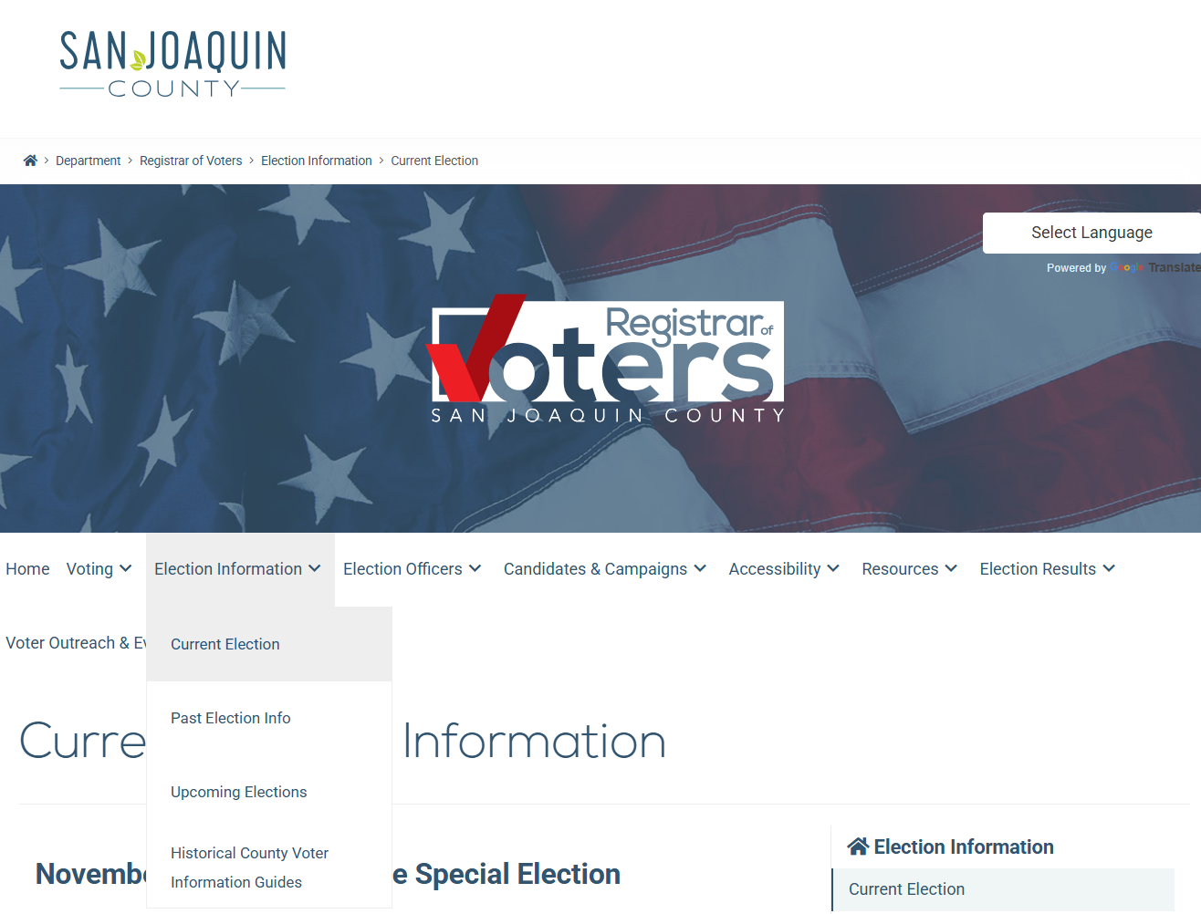
Current Election Documents
Election
Calendar
Offices up for Election
Documents are available at the Registrar of Voters Office and are downloadable online at www.sjcrov.org under
Election Information- Current Election
Candidate
Guide

Slide 3
Before You File
Visit the Secretary of State (SOS) website – voterstatus.sos.ca.gov
Verify that your voter registration information is accurate
If incorrect, re-register promptly to ensure eligibility
Confirm the office and position you are filing for
Ensure and have proof of any qualifications for that office
Decide how you want your name to appear on the ballot
Determine if you will have a ballot designation and a backup choice
Have your authorized agent/campaign contact information ready

Slide 4
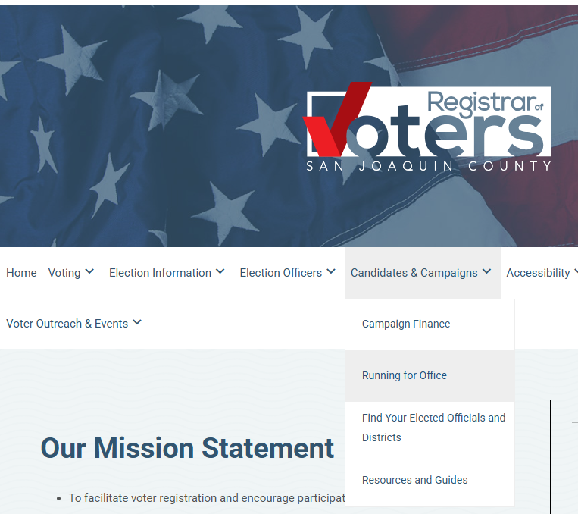
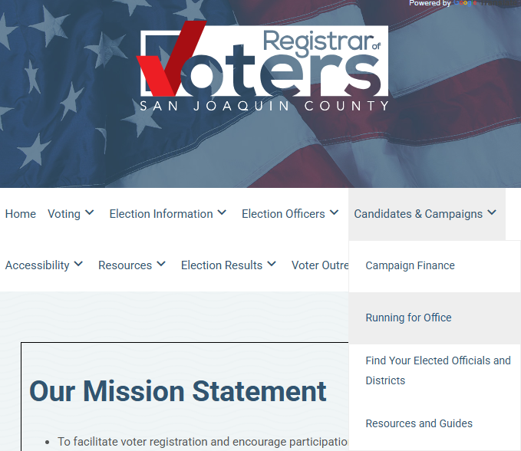
First Steps of Filing
Request an appointment via the Candidates & Campaign tab and selecting Running for Office on the ROV website at www.sjcrov.org
Upon receipt of the appointment request, a confirmation email containing nomination papers will be sent for you to complete before your in-person appointment.
Setting an appointment is strongly encouraged as there may be a long wait time for walk-in candidates. Expect to spend 30-60 minutes to complete the filing process.

Slide 5
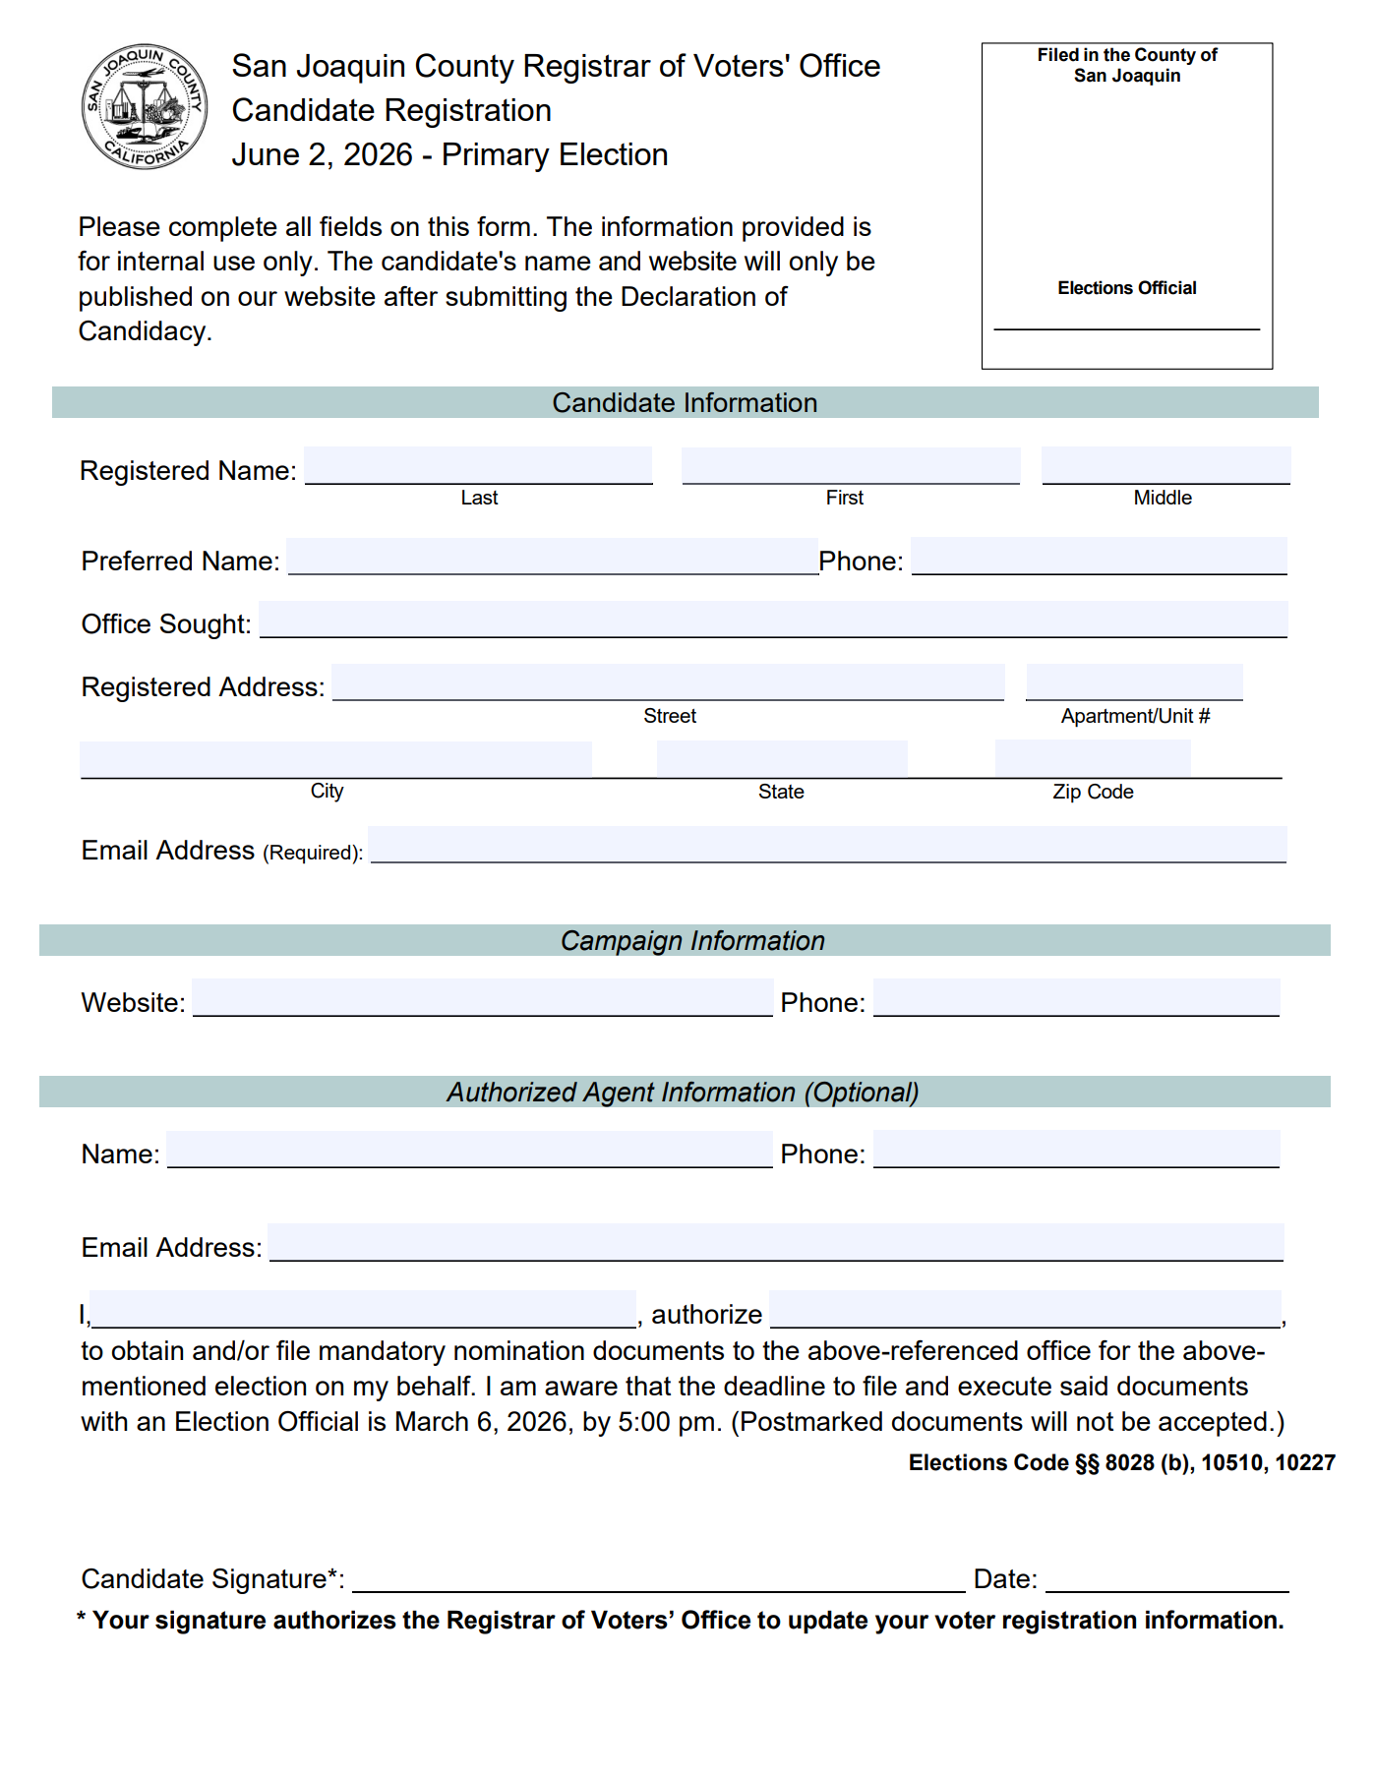
Candidate Registration Form
Registration form must be filled in completely.
This form allows election officials to ensure that you are eligible to run for the office you are applying for.
You may designate a specific person to obtain and/or file nomination papers and/or a Declaration of Candidacy form on behalf of the candidate.
Authorized Agent Information will be provided as part of the candidate registration and must be properly completed and signed before either obtaining or filing nomination papers.

Slide 6
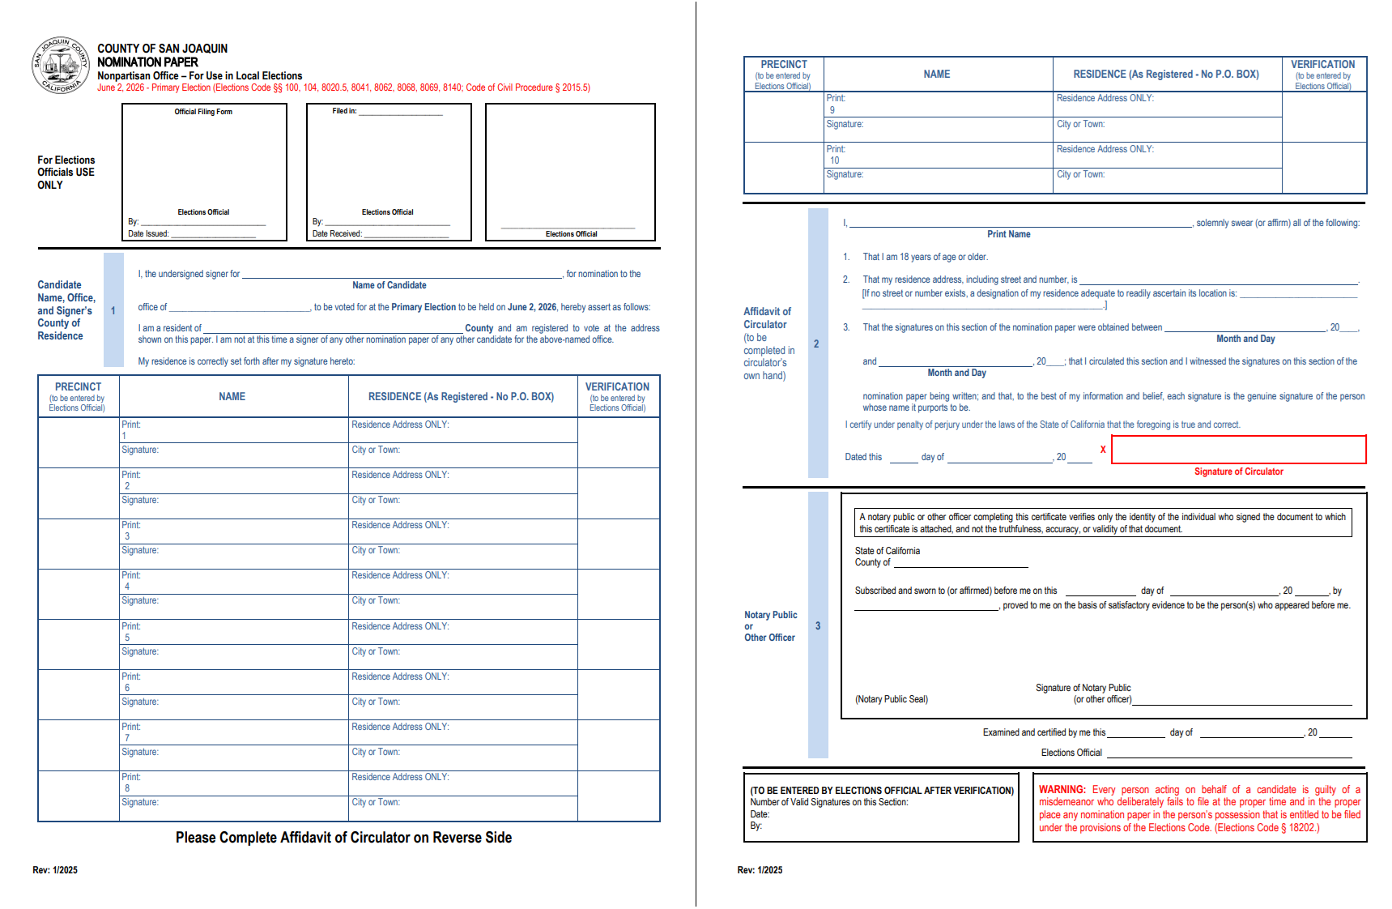
Nomination Petitions
Please refer to the current list of offices up for election to see the offices that require nomination signatures.
Requirements for signers:
Be a registered voter within the district, division, or ward.
Print their residential address, name, and signature.

Slide 7
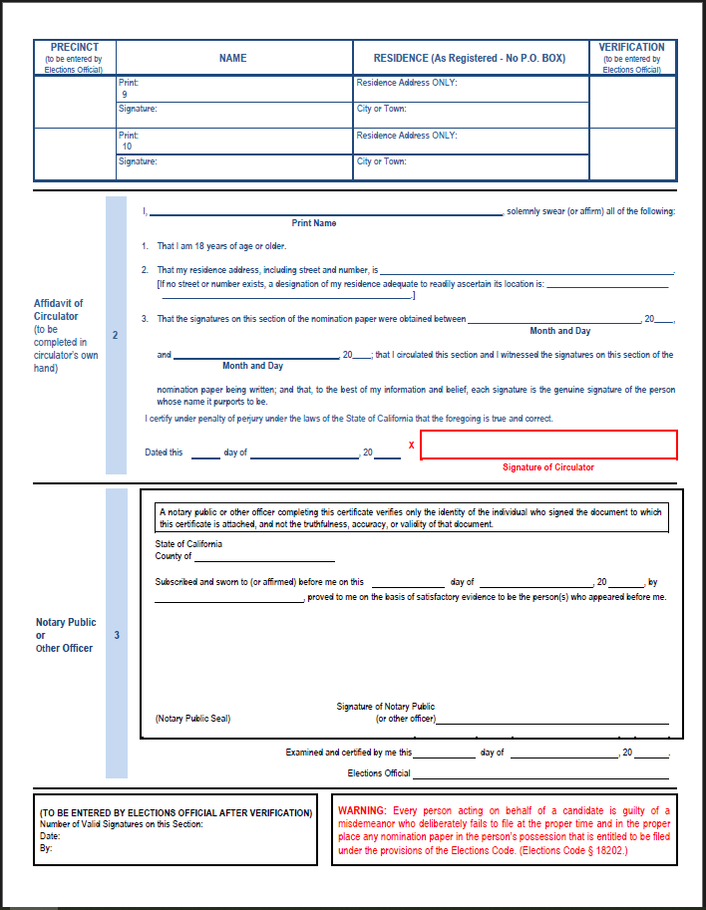
Nomination Petitions
Affidavit of the Circulator
Candidates may circulate their petitions.
Circulator must be 18 years of age or older and must complete this section of the Nomination Petition.
The bottom portion of the form is reserved for the election official.

Slide 8

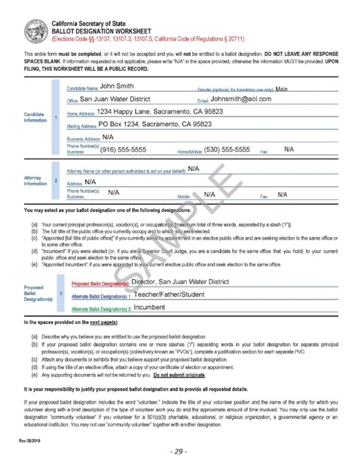
Ballot Designation Worksheet
ALL FIELDS MUST BE COMPLETED
The Proposed & Alternate Ballot Designation section is limited to three words and must be your elective office, current profession, vocation, occupation, or the words incumbent or appointed incumbent.
If you are an incumbent, you may use your official district designation which will be counted as one word.
If the information requested does not pertain, please mark the response as N/A.
Complete the gender option which will be used for translation purposes only.
* More information concerning appropriate ballot designations can be found in the candidate guide

Slide 9

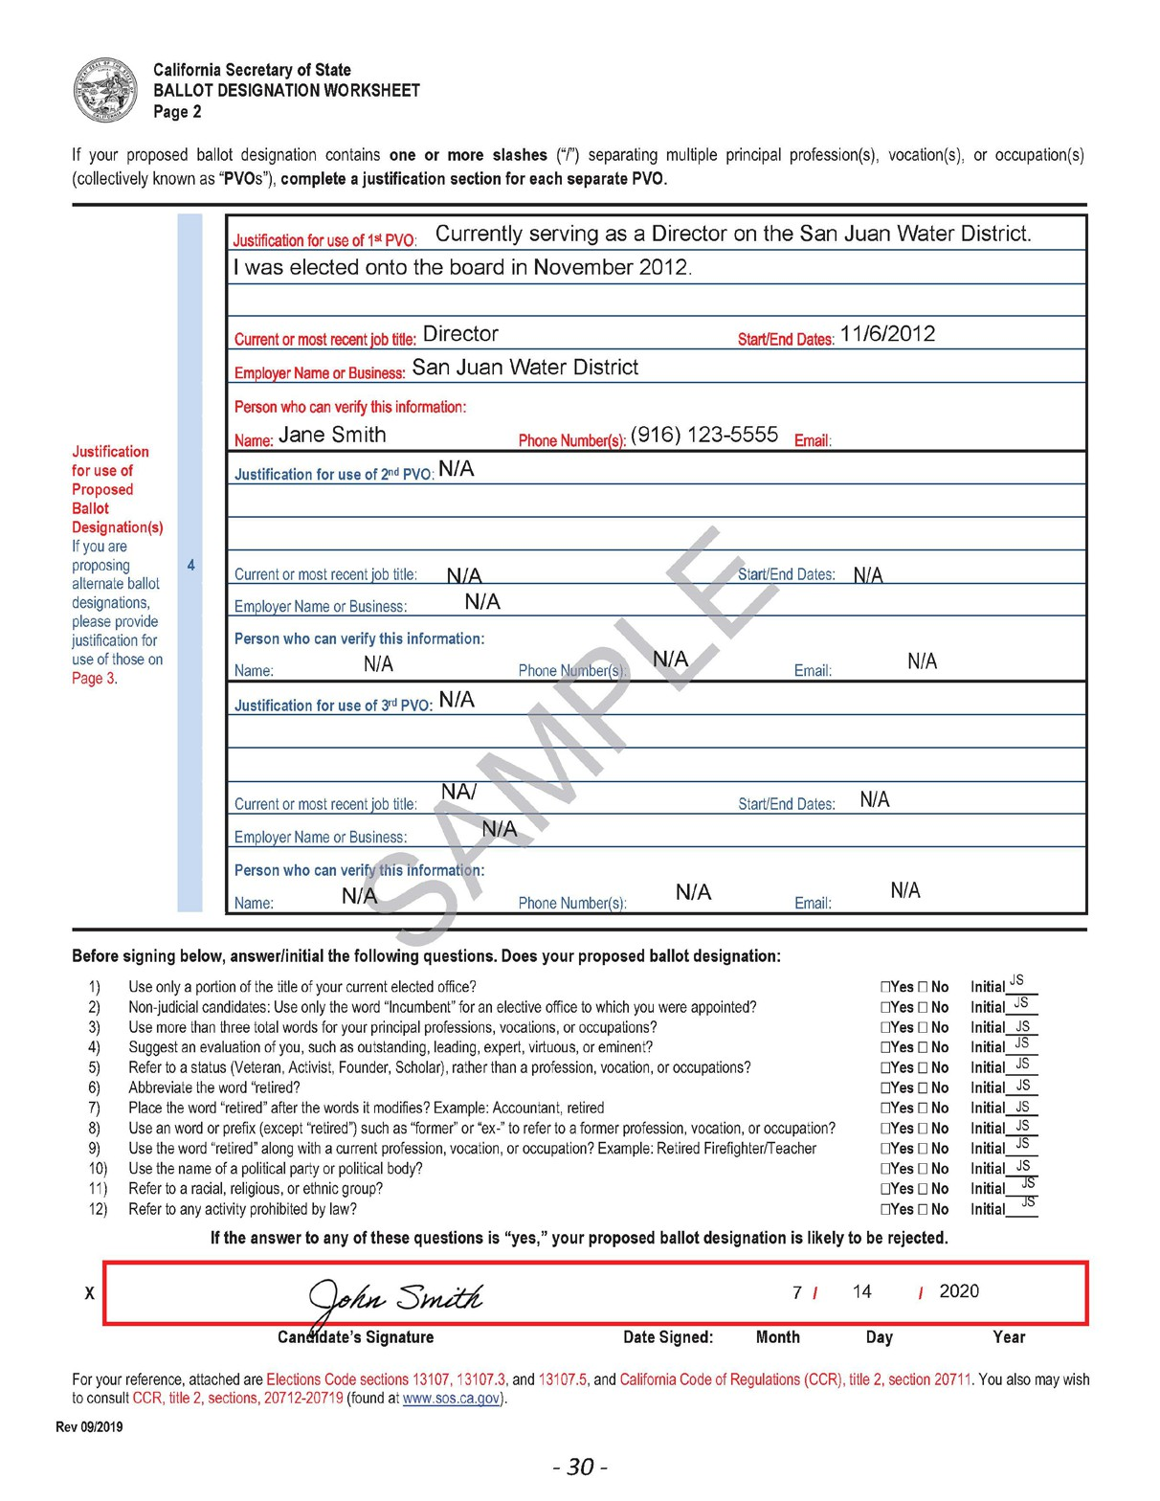
Ballot Designation Worksheet
A justification is additional information about why you, the candidate, is proposing using the ballot designation.
This includes a brief description of your duties and a contact who can verify the information is correct; this may include a family member.
Make sure to answer and initial each question and sign and date the bottom.

Slide 10

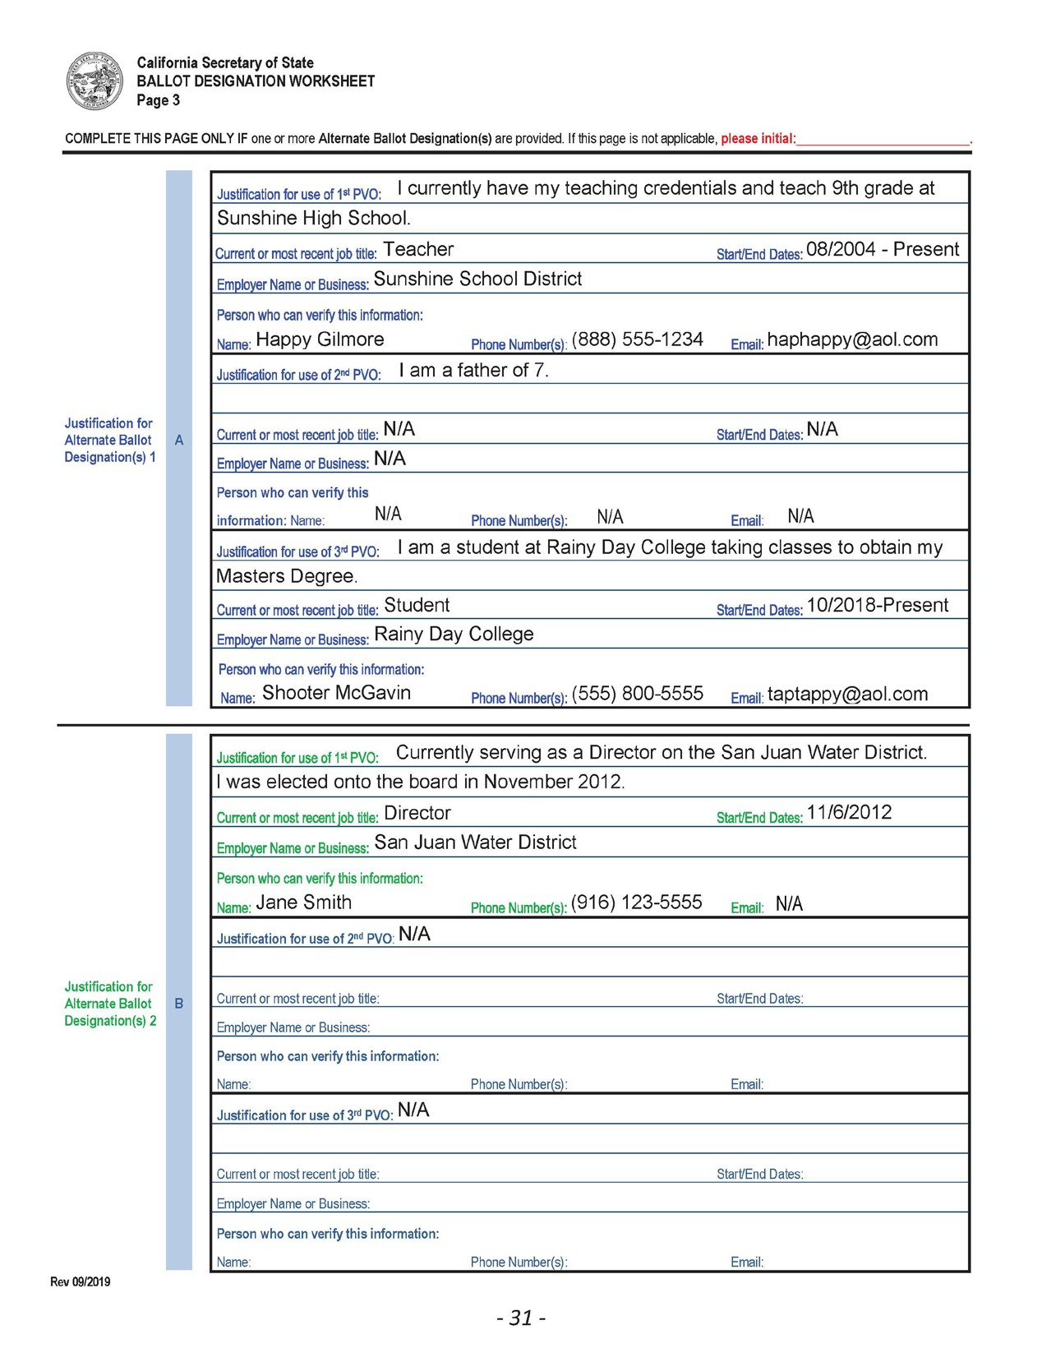
Ballot Designation Worksheet
If you decide to add an Alternate Ballot Designation from the first page, use section A for the justification.
If you decide to add a Second Alternate Ballot Designation from the first page, use section B for the justification.
If you are not adding any Alternate Ballot Designations, you are only required to initial the form at the very top.

Slide 11
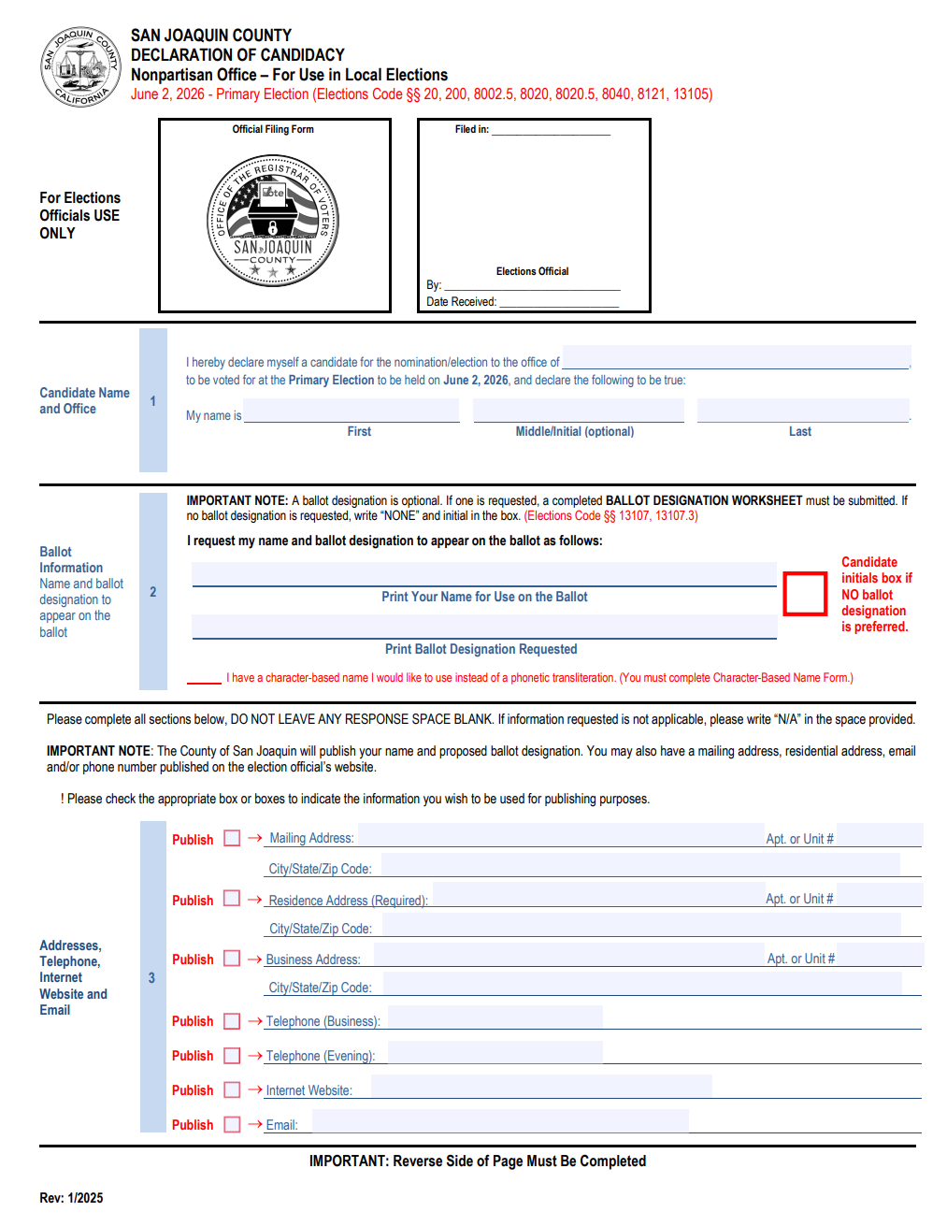
Declaration of Candidacy
Section 1: You will print your name and office sought, including council district if applicable.
Section 2: You will print your name for use on the ballot as well as the desired ballot designation.
A check box is provided for candidates who prefer not to use a ballot designation.
Section 3: The residence address field is required.
The ROV makes available to the public a candidate roster in which your name and Ballot Designation will appear.
We encourage you to provide additional contact information. Organizations often review the candidate report in hopes of inviting prospective candidates to forums,
community meetings, and interviews.

Slide 12
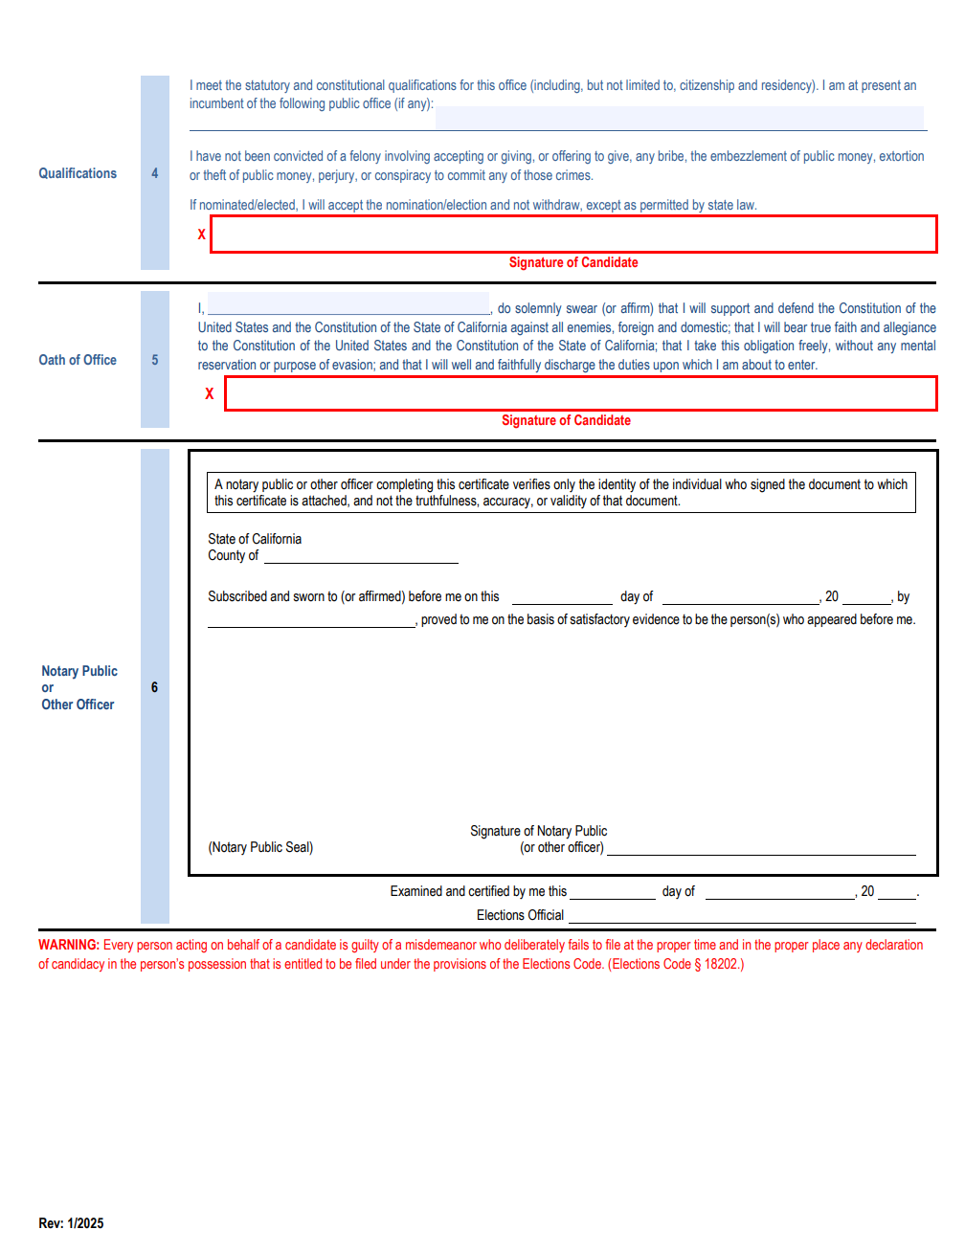
Declaration of Candidacy
Section 4: If you are an incumbent, place the name of the office on this line.
All candidates are required to sign in the red boxes.
Section 5: Election Officials will administer the Oath of Office for you to sign, this must be completed in their presence.
Section 6: Will be completed by an Elections Official.
NOTE: If the Oath of Office is administered by a Notary Public, the Notary will sign this section. A notary must then place their seal on the form.

Slide 13
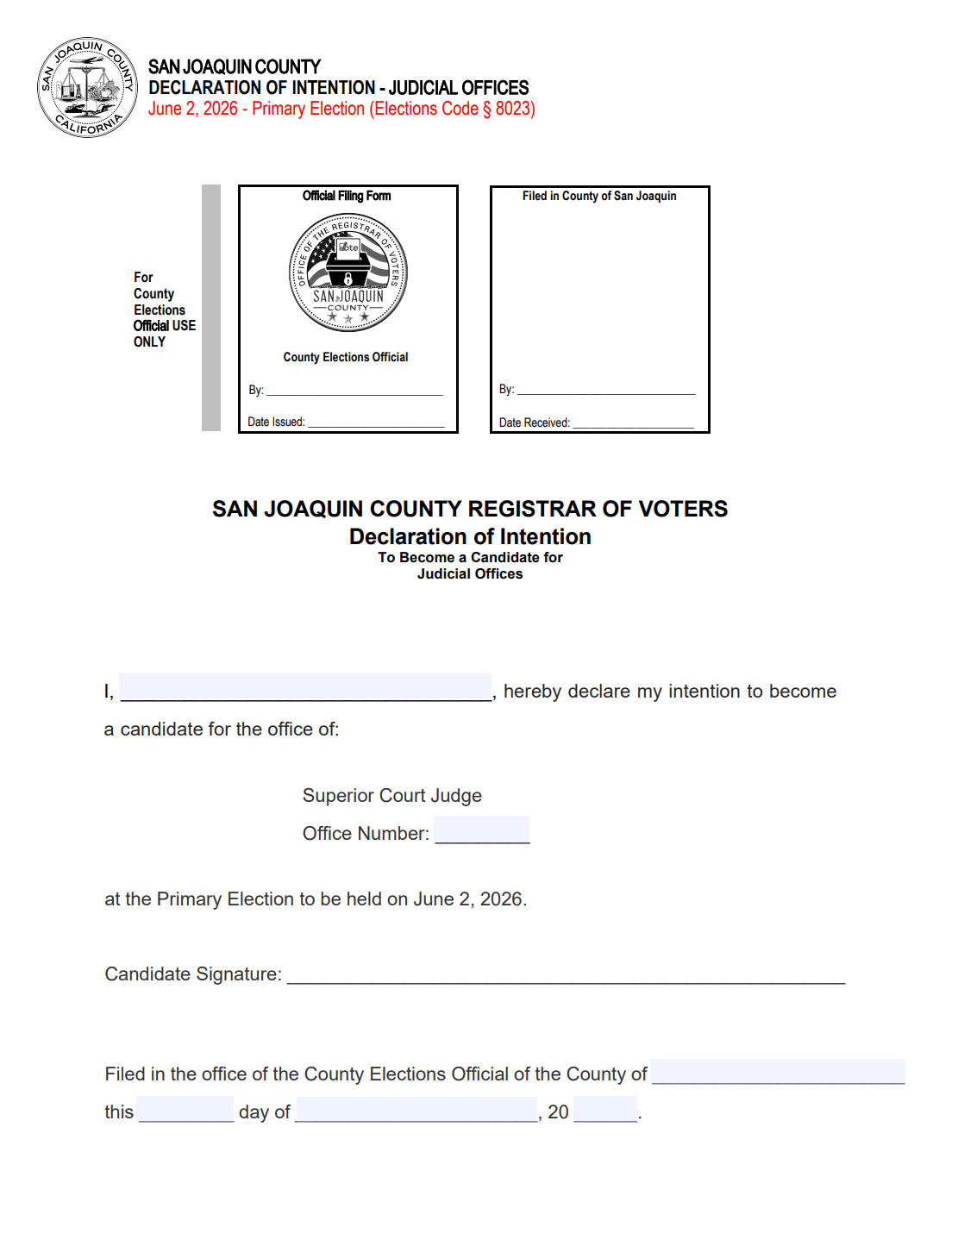
Declaration of Intention
(For Superior Court Judicial Candidates Only)
Candidates for judicial office must file a Declaration of Intention identifying the office for which they intend to run.
(Except in the case of a judicial office filled in accordance with subdivision (d) of Section 16 of the California Constitution)
You will print your name.
A candidate for a numerically designated judicial office shall state in their declaration for which office they intend to become a candidate.

Slide 14
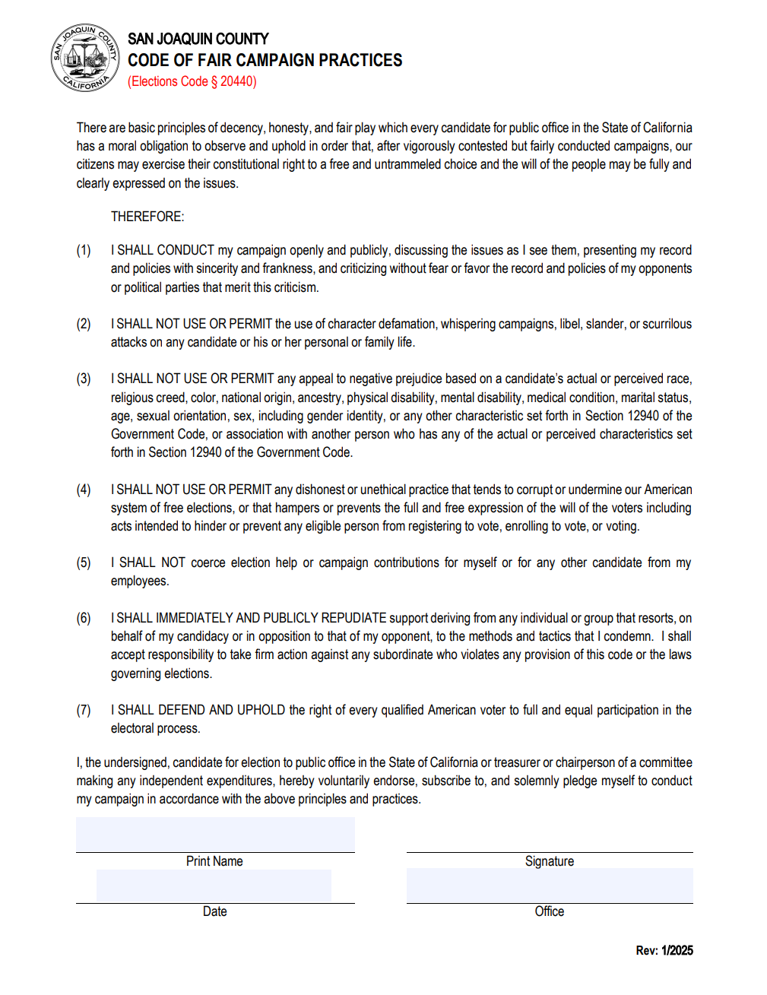
Code of Fair Campaign Practices
This is an optional form and states the candidate plan to run a fair campaign.
California legislation has passed recommendations on how candidates should run a fair campaign.
Should the candidate choose to complete this form, please sign and date the bottom.
NOTE: Once filed this form becomes a public document.

Slide 15
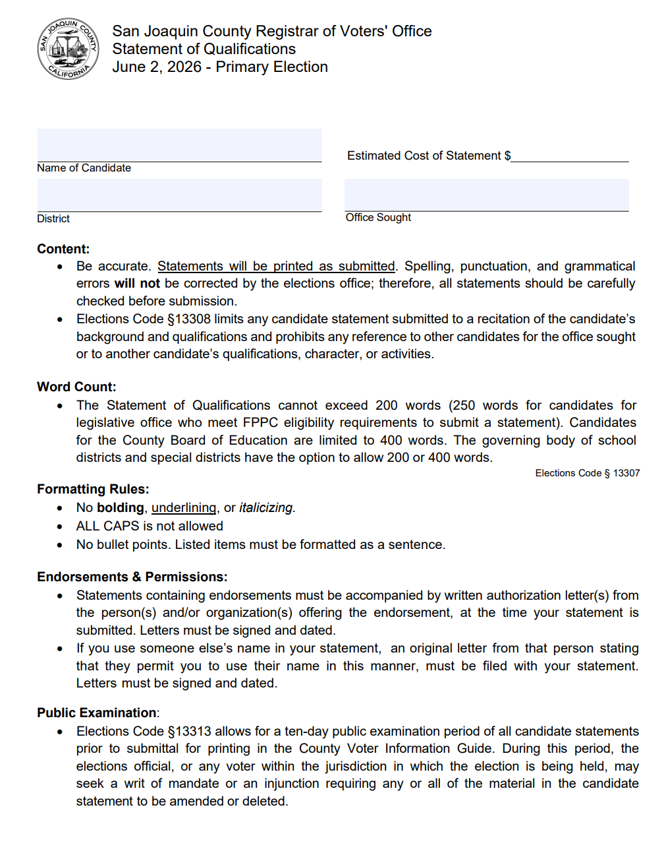
Statement of Qualifications
The optional candidate’s Statement of Qualifications is published in the County Voter Information Guide. Its purpose is to explain the candidate’s qualifications and experience to voters.
Review the candidate statement for spelling, grammar, and all other requirements listed on the cover sheet and candidate guide before filing. Once submitted, it cannot be changed.
Word Limit: 200 words in most cases (250 in some cases)
County Board of Education: 400 words
Schools and Special Districts:
200 or 400 words (governing body’s decision)

Slide 16
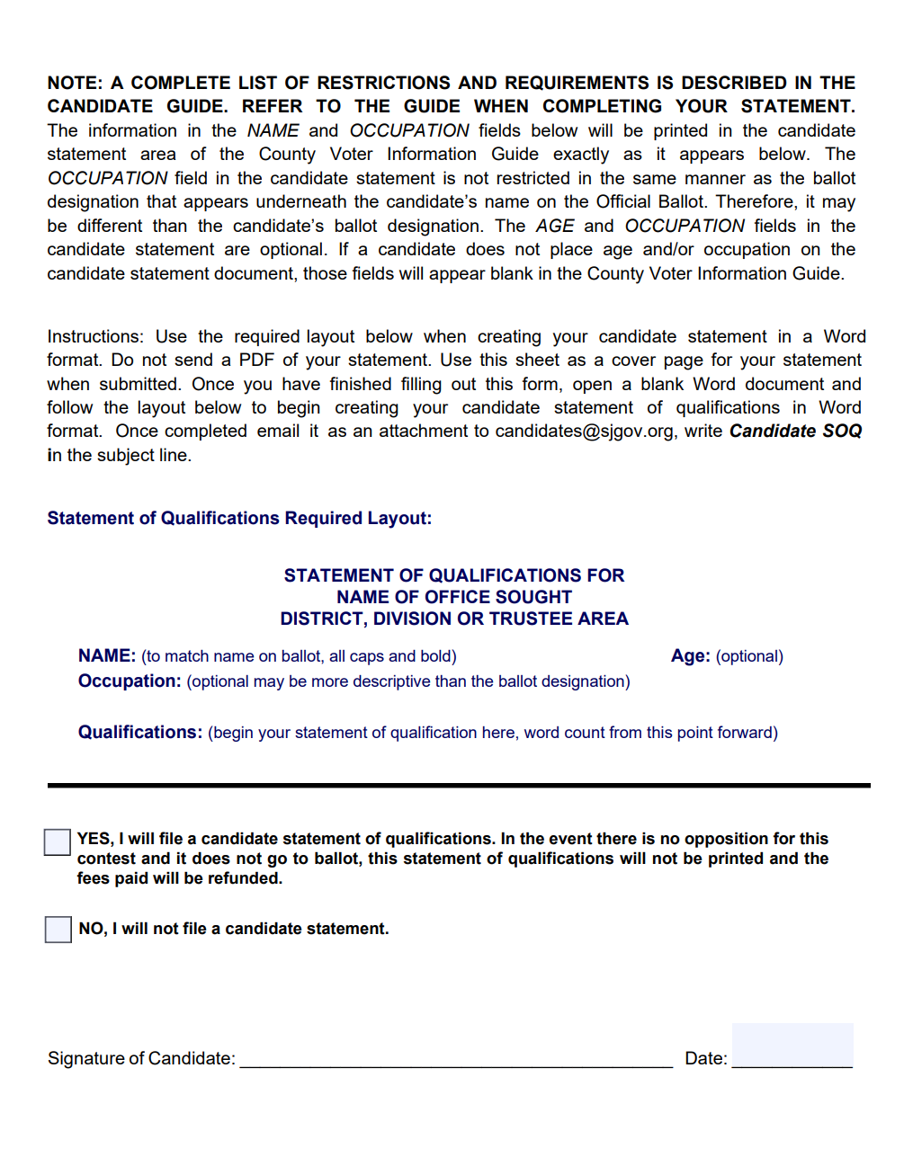
Statement of Qualifications
The statement must be typed.
Payment will be based on the estimated cost to print.
To submit a Statement of Qualifications, email the candidate statement in a Word document before your filing appointment. DO NOT send as a .PDF or image format.
NOTE: Please complete the Candidate Statement Cover Sheet even if you are not submitting a candidate statement. There is a section above the date and signature line that indicates no statement will be filed.

Slide 17
Run Off
Optional - If you are a candidate that is advancing from the Primary Election, you will have the option to submit a new candidate statement along with the estimated costs.
Make your check or money order payable to: County of San Joaquin Registrar of Voters.
Review Candidate Guide for more information.
Contact the Candidate Services Division regarding estimated costs.

Slide 18
Close of Filing Period
Contests for which the incumbent did not file will go into an extension period, allowing people to file for the office for an additional five days (incumbents cannot file during the extension period).
A Qualified list of candidates will be published on our website as often as possible during the filing period.
All candidates who are issued nomination papers by email or in-person will be required to acknowledge that all original, signed nomination documents are due in our office on the last day of the filing period.

Slide 19
Write-In Candidates
Candidates that wish to run as write-ins may complete a Statement of Write-in Candidacy Form during the write-in candidacy filing period
Signers of nomination petitions:
Signers of nomination petitions for write-in candidates shall be voters in the district or political subdivision in which the candidate is to be voted on
Filing Fee:
No fee shall be required of a write-in candidate
Statement of Qualifications:
Write-in candidates may not file a Statement of Qualifications (candidate statement)

Slide 20
FPPC
The Fair Political Practices Commission is a five-member independent, non-partisan commission that has primary responsibility for the impartial and effective administration of the Political Reform Act. The Act regulates campaign financing, conflicts of interest, lobbying, and governmental ethics.
The Commission’s objectives are to ensure that public officials act in a fair and unbiased manner in the governmental decision-making process, to promote transparency in government, and to foster public trust in the political system.

Slide 21
NetFile
All FPPC statements mandated by the California Political Reform Act are required by county ordinance to be filed electronically. While filers who make and receive campaign expenditures and contributions totaling less than $2,000 in a calendar year are exempt from using the electronic filing method, all filers have the option and are strongly advised to do so.
San Joaquin County has contracted with NetFile to be the electronic filing platform for all statements required by the Political Reform Act.
NetFile offers tutorials covering how to effectively utilize and navigate their website. As a first step in using this service, you may find it helpful to watch the “How to Create a New Campaign NetFile User” video in the “Videos” section of the page at www.netfile.com/filer.

Slide 22
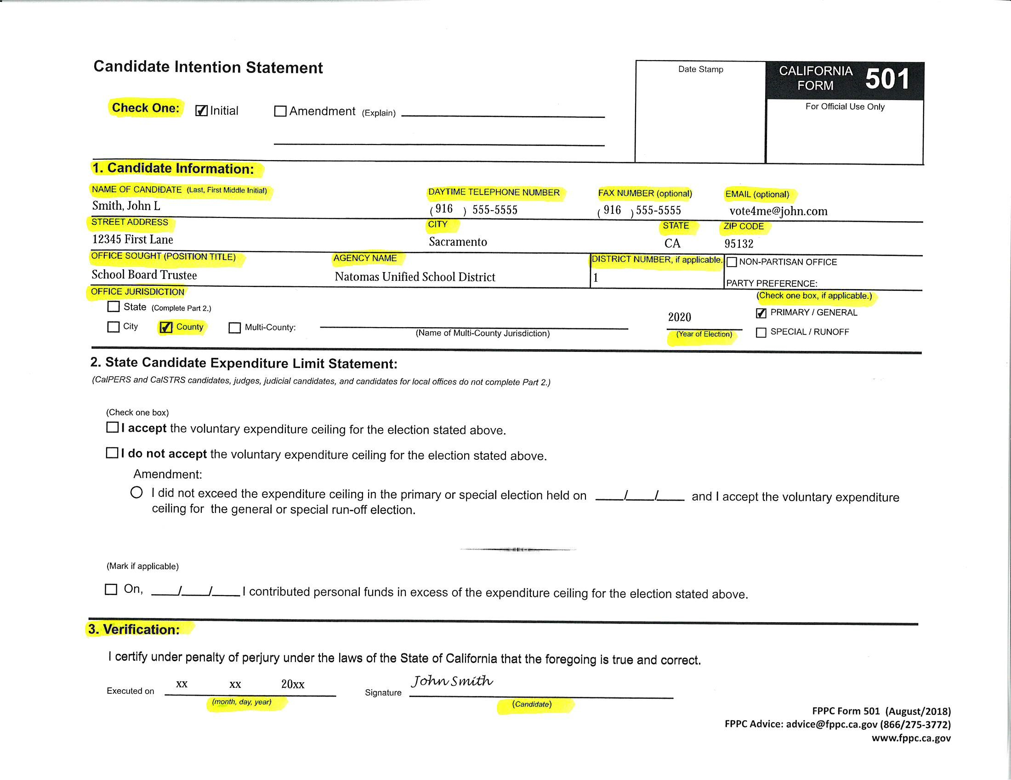
Form 501
Candidate Intention Statement
All candidates who plan to solicit or receive contributions or make expenditures from personal funds related to campaigning must file a Form 501 before soliciting or receiving contributions.
Instructions
Select a box at the top of the form indicating whether this is an Initial statement or an amendment to a previously filed form.
Section 1: Provide full name, street address, contact information, office sought, and the year of the relevant election.
Section 2: Do not enter any information in Section 2 unless you are a state candidate.
Section 3: Sign and date the form.

Slide 23
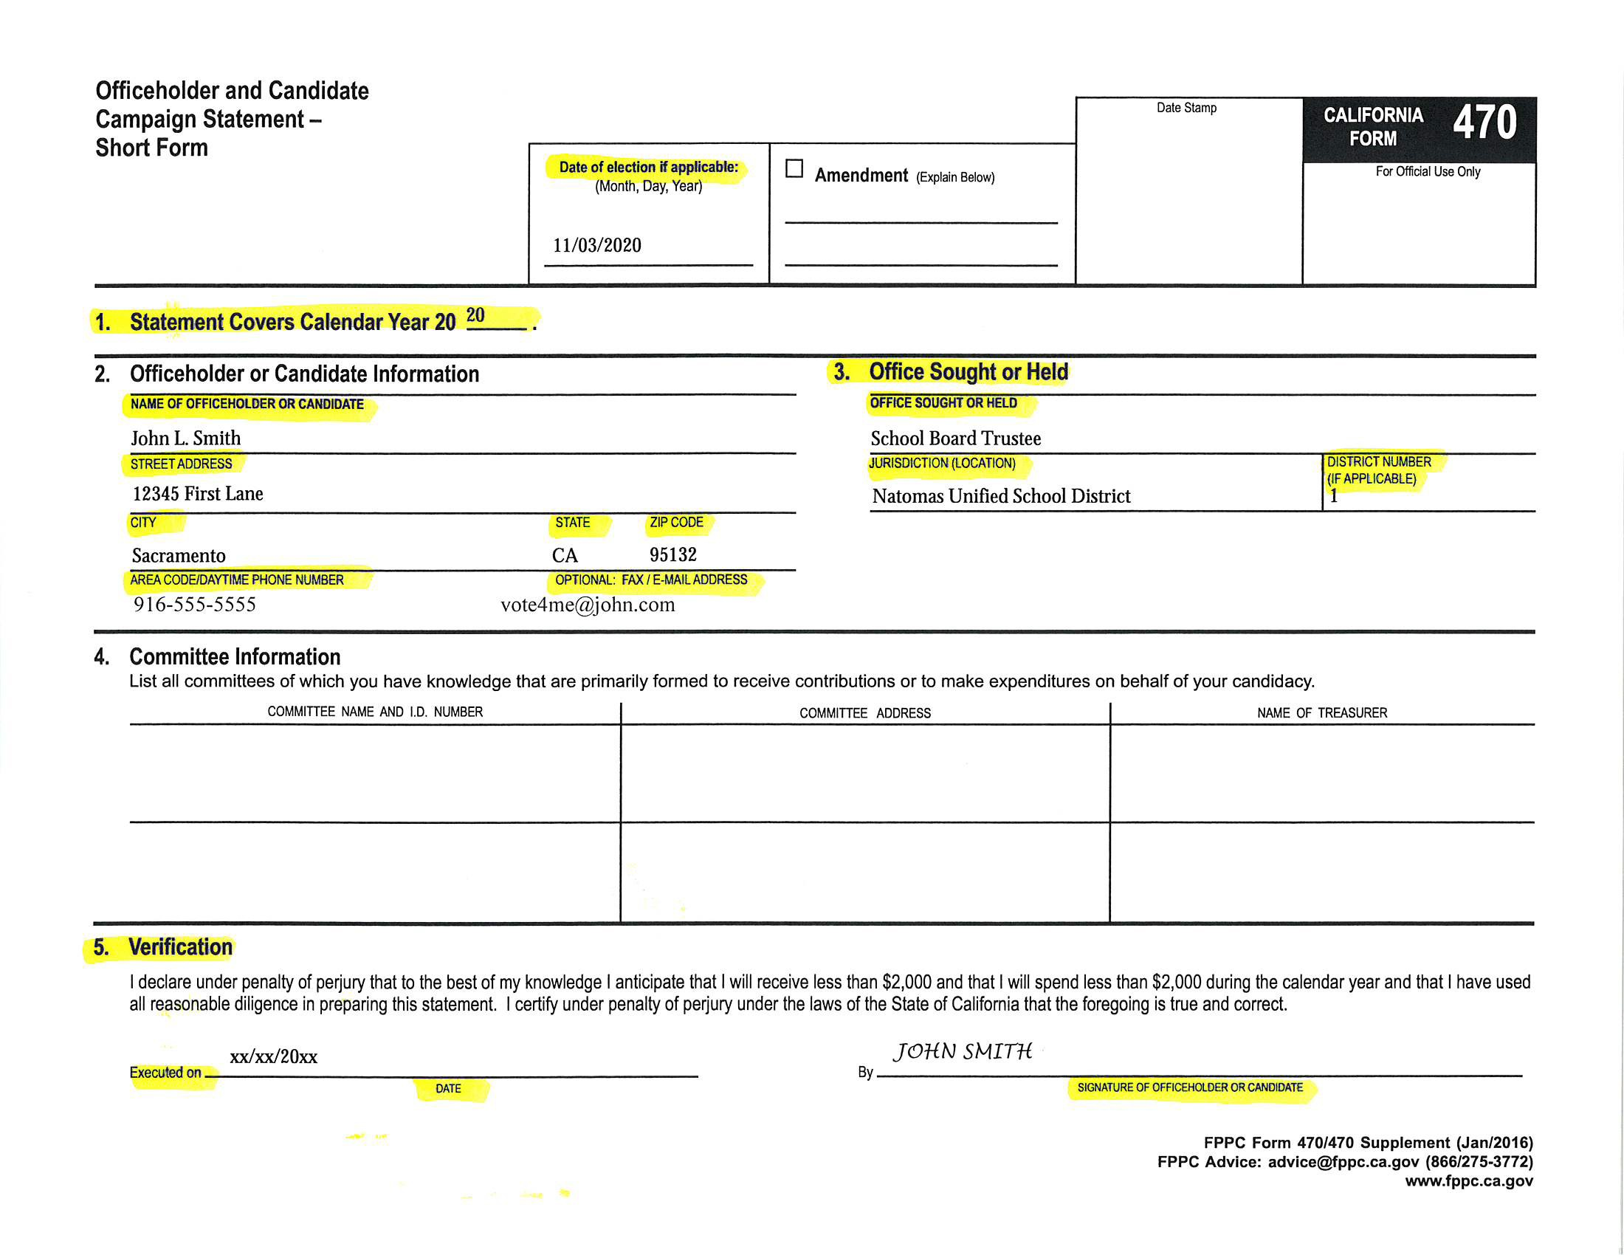
Form 470
Officeholder and Candidate Campaign Statement – Short Form
All candidates who do not have an active committee, established in anticipation of spending/receiving $2,000 or more in connection with their campaign for office, must file a Form 470 no later than the time of filing their Declaration of Candidacy.
- Judicial candidates may be exempt under specific circumstances. Please contact Candidate Services for more information.
Instructions - Complete the top of the form with the date of the election for which you are filing.
Section 1: Provide the year of the election for which you are filing.
Section 2: Provide full name, street address, and contact information.
Section 3: Provide the title of the office sought or held, the name of the agency to which the office belongs, and the division or area number if applicable.
Section 4: Leave this section blank unless you wish to report a candidate- controlled committee.
Section 5: Sign and date the form.

Slide 24
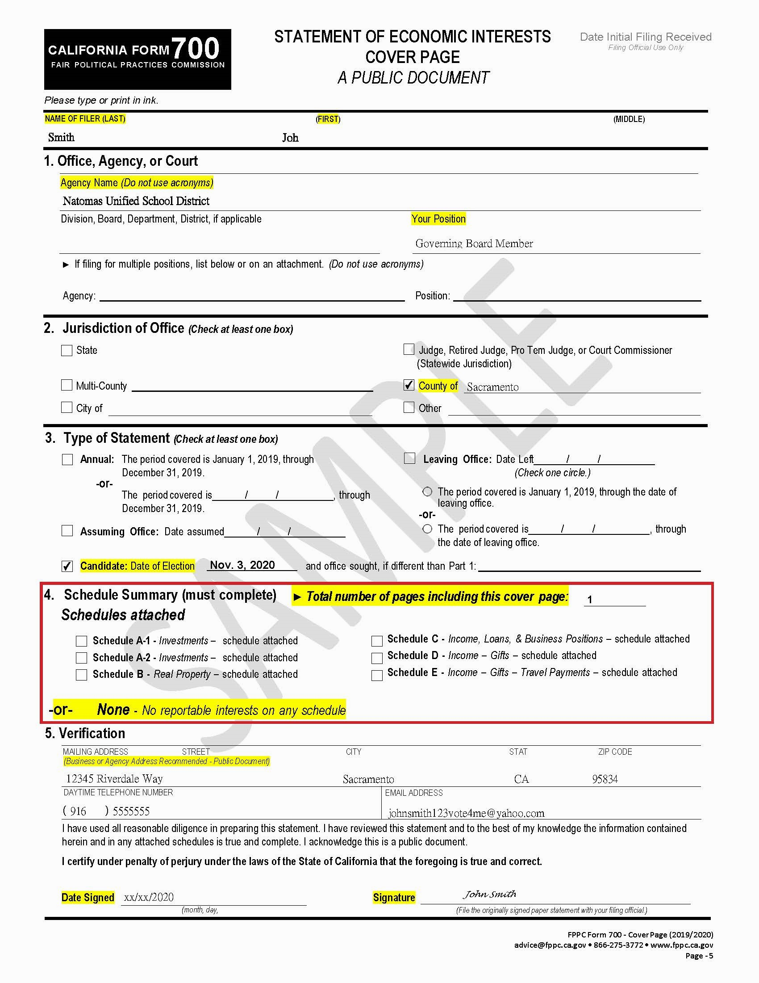
Form 700
Statement of Economic Interests
All candidates running for local elective offices are required to complete a Form 700 Statement of Economic Interests.
Provide your first and last name before proceeding.
Section 1: Provide the name of the agency and title of the office sought as the position.
Section 2: Check the box for “County” and specify “San Joaquin”.
Section 3: Check the box for “Candidate” and provide the date of the relevant election.
Section 4: If you do not have schedules to attach, enter “1” for the total number of pages of the statement. If you have schedules to attach, please check the appropriate boxes identifying which are attached and specify the total number of pages of the statement, including the cover page.
Section 5: Complete this section, including date and signature.
Note: If you are the incumbent running for the office you currently hold and have recently filed an Annual Form 700, you are still required to file a Candidate Form 700 for the upcoming election. This is required to report for the period covered from the end of the previous year reported until the time of filing the Candidate Form 700.

Slide 25
Additional FPPC Documents
Form 410 – Candidates must file this in anticipation of spending/receiving $2,000 or more to campaign for office, establishing a candidate-controlled committee with a bank account designated for all campaign-related financial activity.
Form 460 - Committees must file this summary report of all financial campaign activity semi-annually, regardless of whether to report activity or a lack thereof.

Slide 26
Additional Questions Regarding FPPC
Review the applicable FPPC Campaign Disclosure Manual
All FPPC statement forms can be found on the FPPC website: www.fppc.ca.gov
Email: advice@fppc.ca.gov
Phone: 1-866-ASK-FPPC (1-866-275-3772)
  Telephone advice is available:
  Mon - Thu, 9:00 a.m. - 11:30 a.m.

Slide 27
Questions?
Contact The Candidate Services Division
San Joaquin Registrar of Voters Office
Candidate Services Division
Address: 44 N. San Joaquin Street, Suite 383
Stockton, CA 95202
Phone: (209) 468-8945
Email: candidates@sjgov.org
Please contact your city clerk for more information and requirements if you are city candidates.

